Slide 1
Management of Subcontractor Default Through Insurance
Florida Bar RPPTL – Insurance and Surety Law Committee
Monday, January 28, 2019
Eric M. Gold, Counsel
Stephen S. Asay, Senior Associate
Pillsbury Winthrop Shaw Pittman LLP

Slide 2
Management of Subcontractor Default
Surety Bonds
  A surety product that indemnifies the obligee from a loss as a result of a specific subcontractor or supplier default
Subcontractor Default Insurance (SDI)
  A blanket policy that indemnifies a general contractor from a loss incurred as a result of a default by an enrolled subcontractor or supplier on the project
  Provides an alternative to individual subcontractors obtaining payment and performance bonds to guarantee contract performance

Slide 3
Bonds v. SDI: Bonds
General Contractor (GC) (Obligee)
Surety
Subcontractor/Supplier
(Principal)
Three-party relationship
Sub negotiates with surety; bond project-specific
GC pays sub for bonds and limits of coverage
Defaulted sub’s surety negotiates claim with GC
Surety’s customer is defaulted sub, not GC

Slide 4
Bonds v. SDI: SDI
General Contractor (GC) (Insured)
Subcontractor Default Insurance Carrier
Two-party relationship
GC negotiates with SDI carrier; coverage typically term-specific
GC pays SDI carrier directly for insurance
SDI carrier indemnifies GC for covered loss
SDI carrier’s customer is GC, not defaulted sub

Slide 5
SDI Programs: Benefits
GC has greater control
  Controls subcontractor selection and qualification
  Controls which jobs are covered
Enhanced protection
  Coverage for certain Soft Costs (“Indirect Costs” subject to sub-limit)
  Coverage extends to statute of repose
Profit Potential
  Dual premium structure (fixed plus variable) rewards successful management
  Good risk management and loss control can result in return of variable premium

Slide 6
SDI Programs: Drawbacks
GC incurs additional overhead costs
  Qualification and risk management
  Billing and reporting
Deductible and co-payment obligations
  Per loss
  Aggregate
Limits may not be adequate
  Large subcontracts
  Defaulted subcontractor on multiple projects

Slide 7
SDI Programs: Insured GC Responsibilities
Qualify all subcontractors covered by the SDI policy
Manage risk covered by the SDI policy
  SDI best suited for use on negotiated projects where selection of subcontractors is based on qualification rather than the low responsive bid
Report subcontractor enrollment to broker/carrier
Cooperate with SDI carrier’s risk engineers

Slide 8
SDI Coverage Triggered by Default:
Direct Costs
Costs within “four corners” of the subcontract
Examples
  Costs of completing defaulted subcontractor’s work
  Costs of correcting defaulted subcontractor’s defective work
  Performance related
  Quality (rip and tear)
  Attorney and consultant fees
  Amounts defaulted subcontractor is required to pay under contract to third parties
  Investigation, adjustment, and other fees directly related to subcontractor’s default
  Defense costs of default challenge
  Acceleration costs of completing subcontractor’s work
  Release of lien bond premiums

Slide 9
SDI Coverage Triggered by Default:
Indirect Costs
Costs outside of “four corners” of the subcontract
Examples
  Extended overhead of GC, owner, other subcontractors
  Overall project acceleration costs (other than acceleration of defaulted subcontractor’s work)
  Overall project delay
  Productivity impact
  Delay and disruption claims of other subcontractors
  Liquidated damages
Indirect costs typically subject to sublimit ($5 million)

Slide 10
SDI Coverage Triggered by Default:
Exhaustion of Subcontract Balance
Costs incurred as a result of default must exceed full balance of subcontract and deductible
Submit interim proofs of loss
Covered costs not contemplated under the defaulted subcontract are recoverable

Slide 11
Common SDI Exclusions:
Subject to Negotiation/Specific Underwriting
Subcontractors providing professional services
(generally if greater than 50% of costs are professional services)
Subcontracts or projects greater than 3 years in duration
Subcontracts greater than $40 million in value
Power projects
Residential projects

Slide 12
Common SDI Exclusions:
Concurrent Causes of Loss
Loss means costs and expenses . . . to the extent caused by and directly related to a Default of Performance of a Subcontractor
No coverage for losses caused by the combination of a Default of Performance and another causative act, omission, or event
  Professional errors
  Excessive ground water
Concurrent delay

Slide 13
Subrogation: Rights and Recoveries
SDI carriers have contractual subrogation rights
Order of recovery
  Uninsured or excess losses
  Covered losses
  Deductibles and co-payments
Replenishment of limits
  Amounts recovered by SDI carrier should replenish policy limits
  Negotiate return of payments and other issues upfront

Slide 14
Subrogation: Pursuing Recovery
Potential sources of recovery
  Defaulted subcontractor or supplier
  Insurance carriers of defaulted subcontractor or supplier
  Insurance carriers of GC or owner (including CIPs)
Potential conflicts of interest
  SDI carriers (as insurance companies) may have conflicts or be unable to make necessary coverage arguments
  GC may be able to negotiate fee and recovery agreement

Slide 15
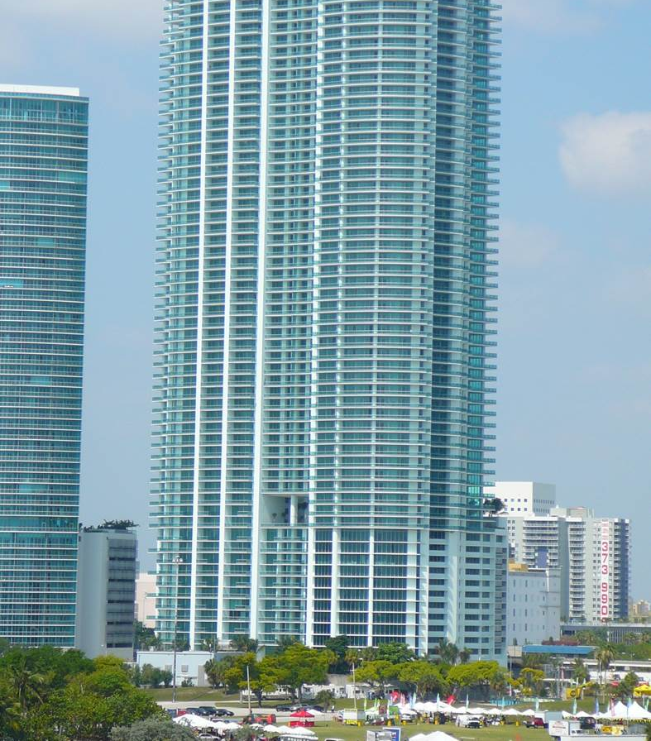
Subrogation Success Story

Slide 16
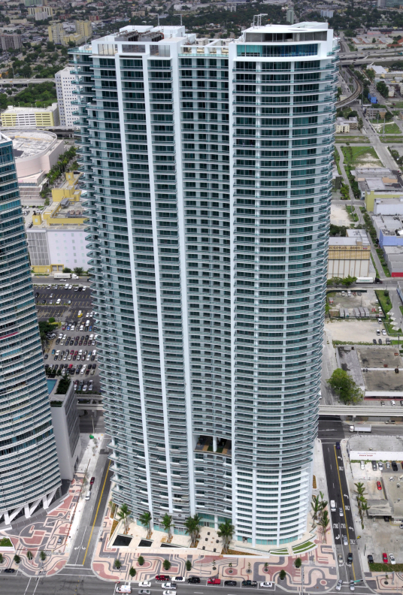
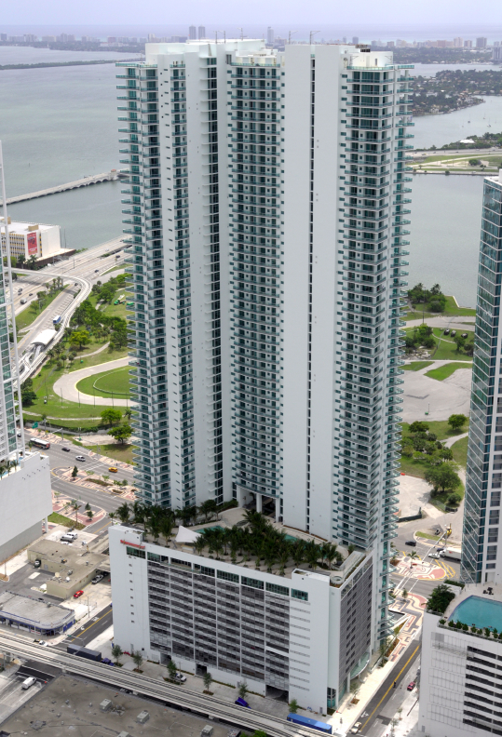

Slide 17
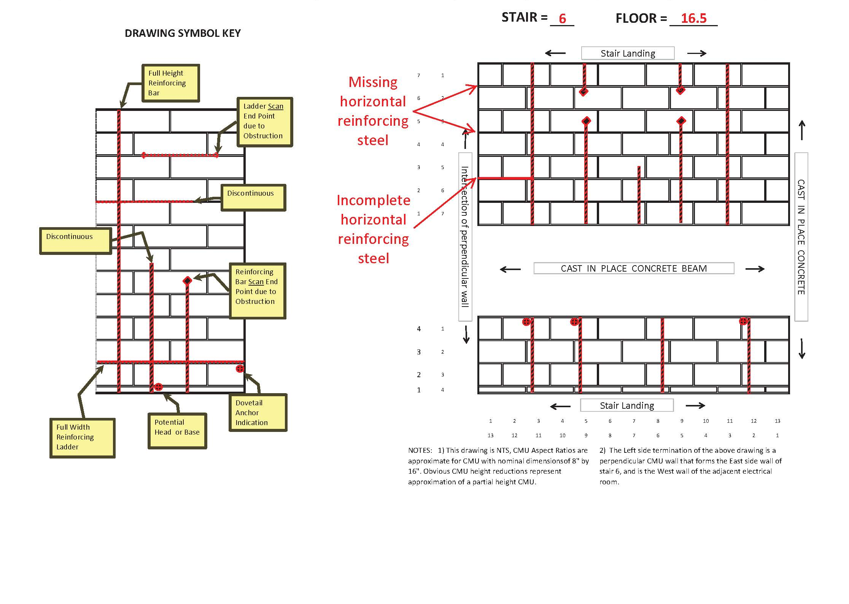
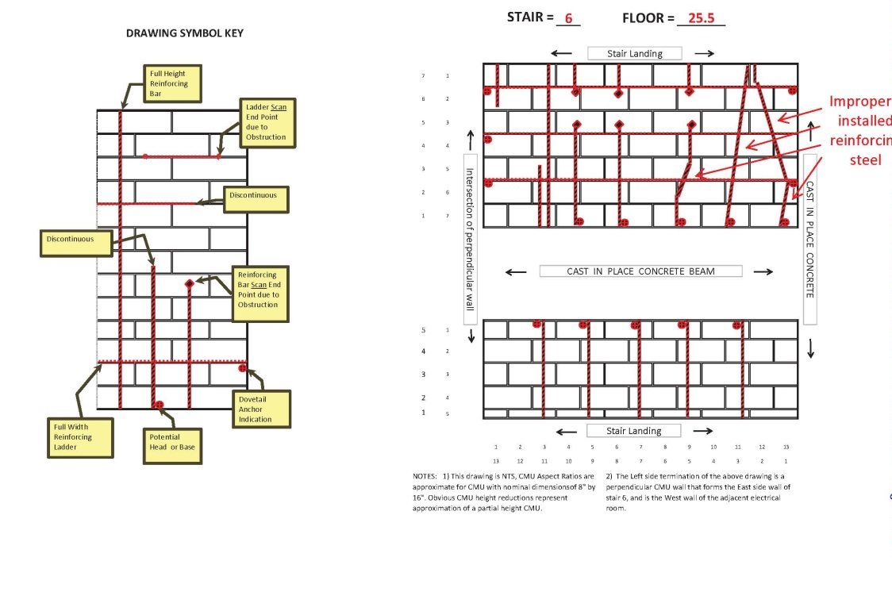

Slide 18
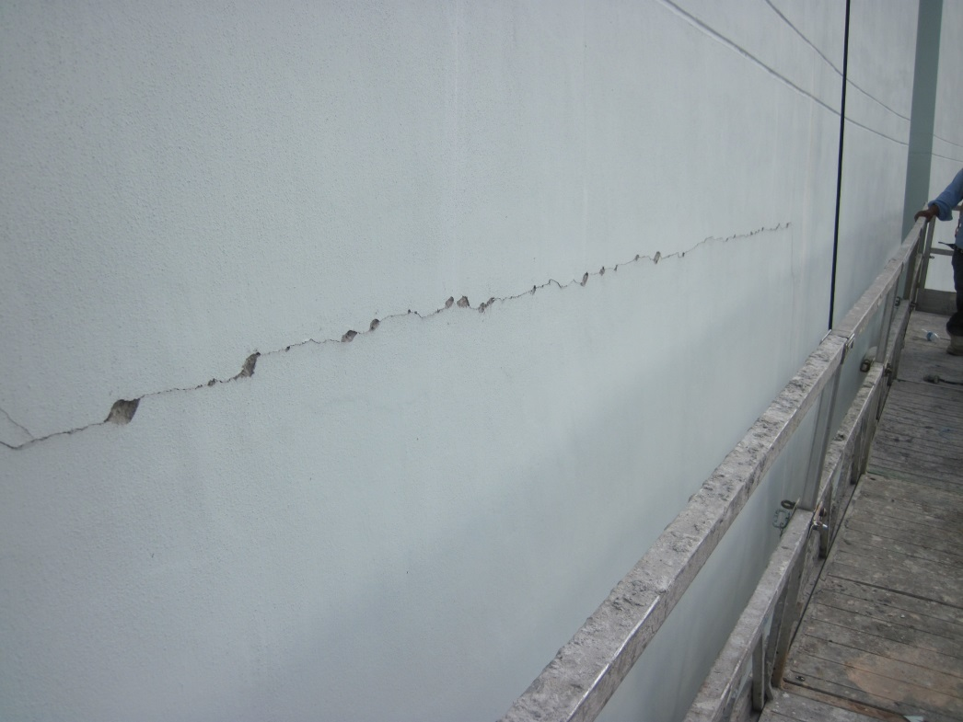
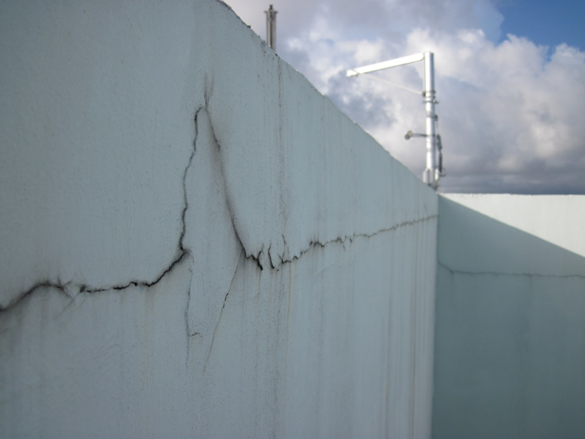
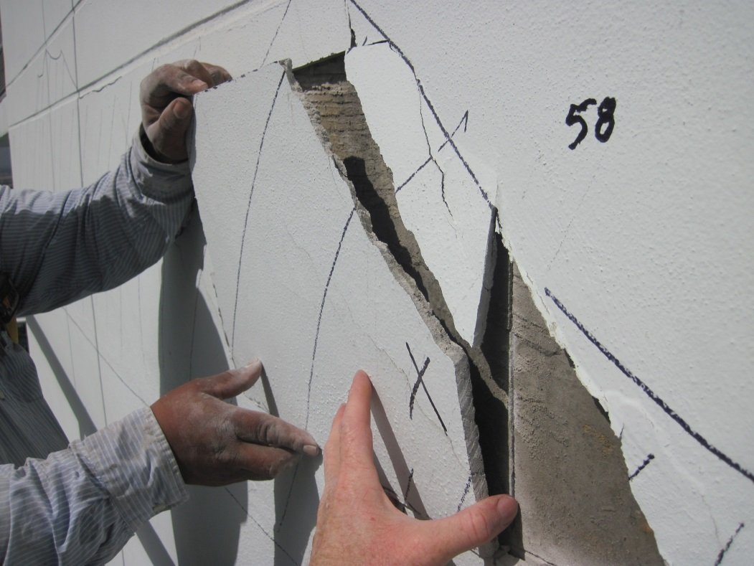
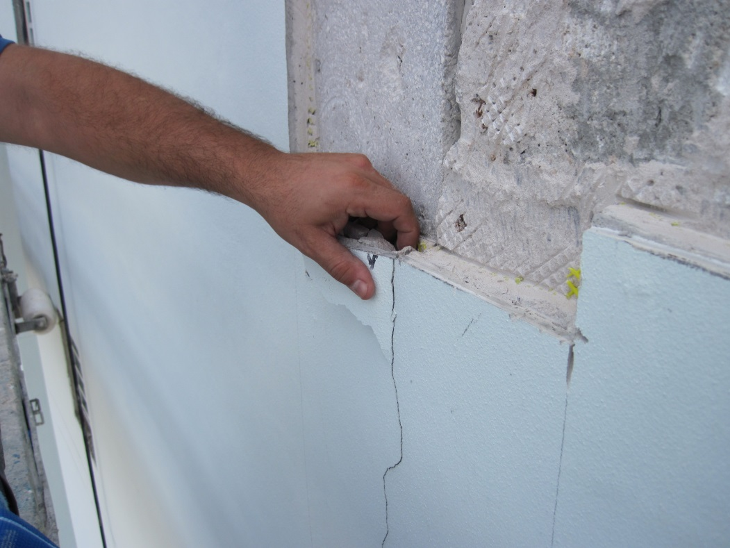

Slide 19
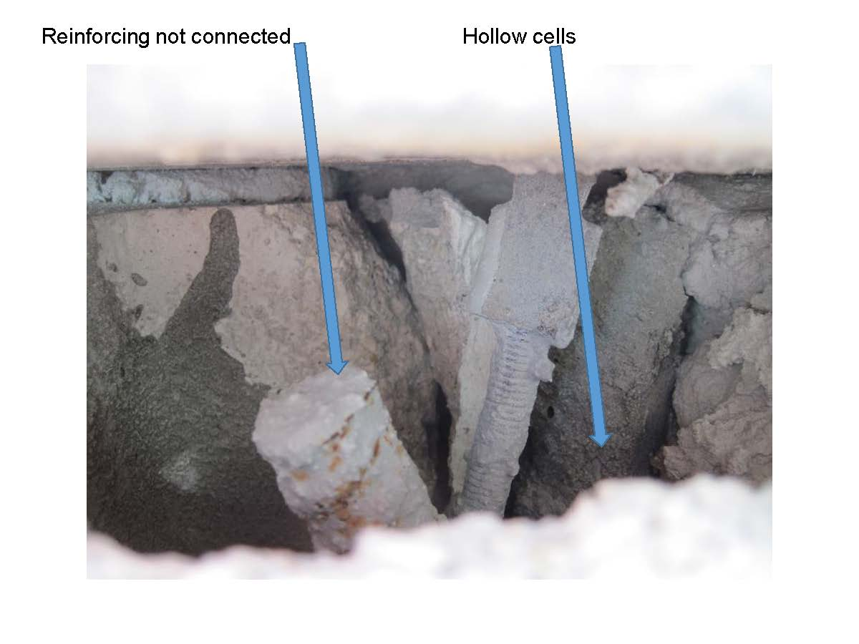
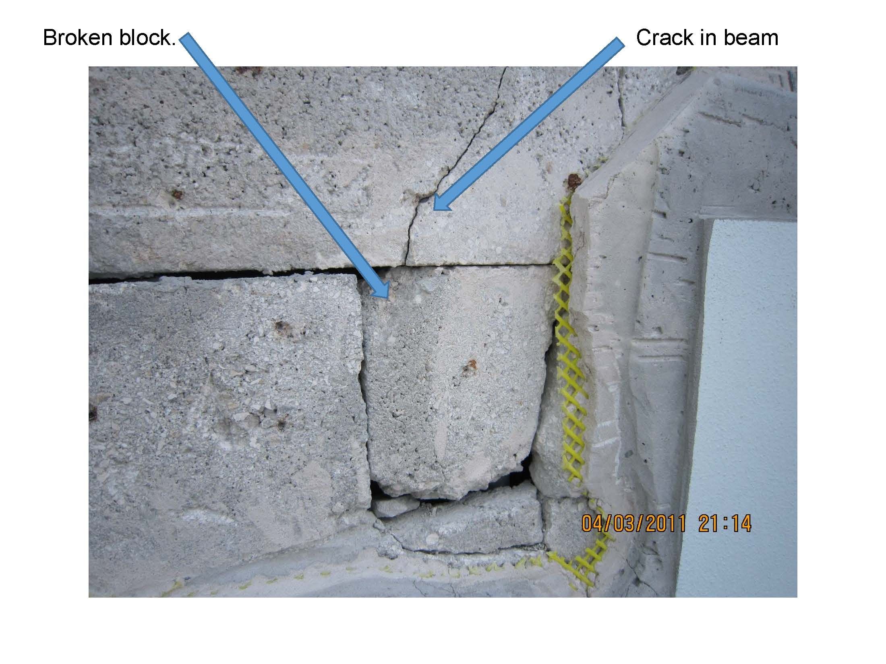
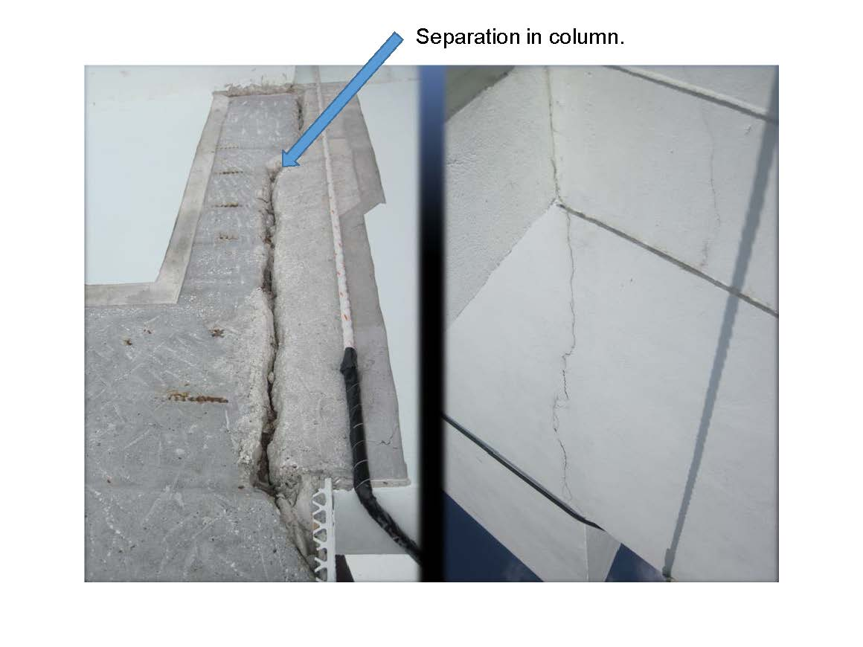
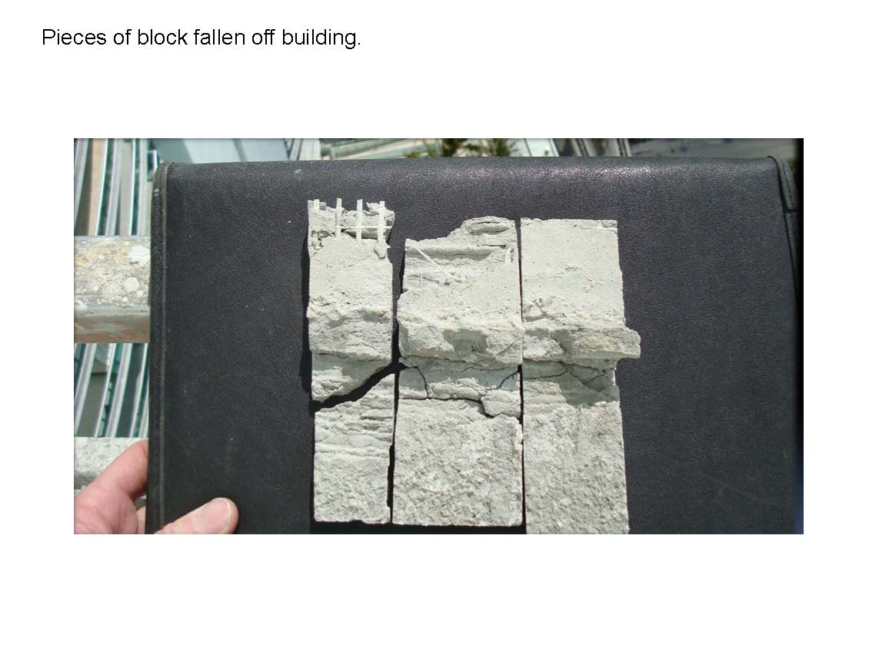

Slide 20
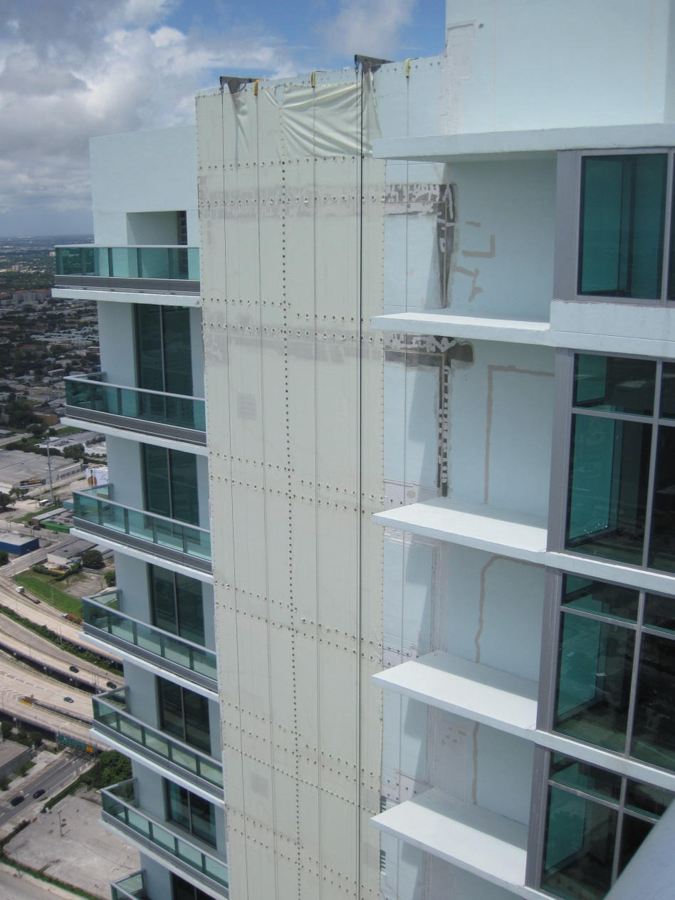
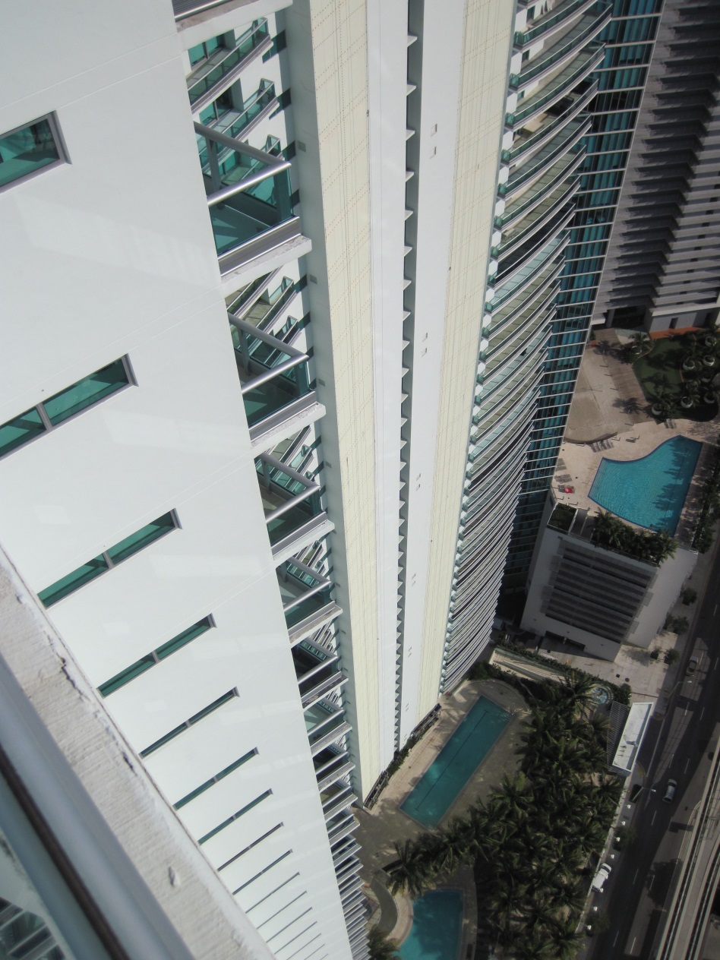

Slide 21
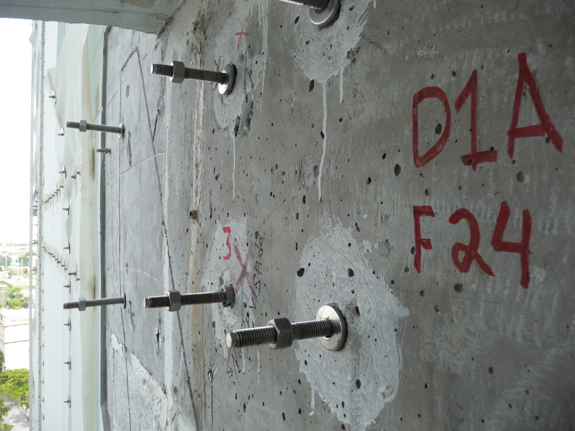
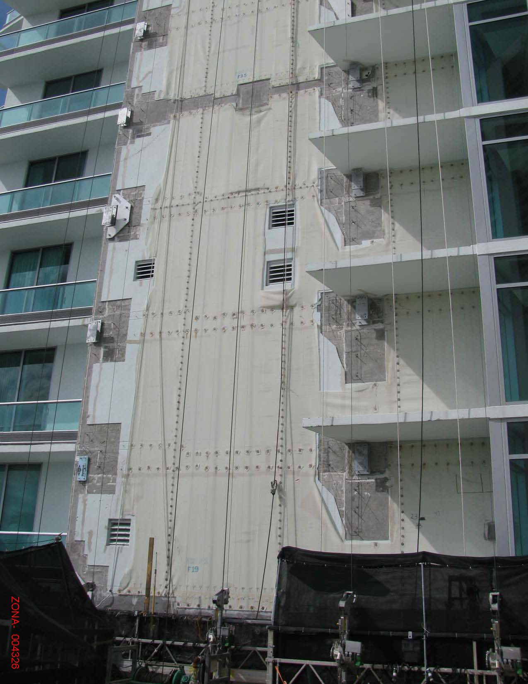
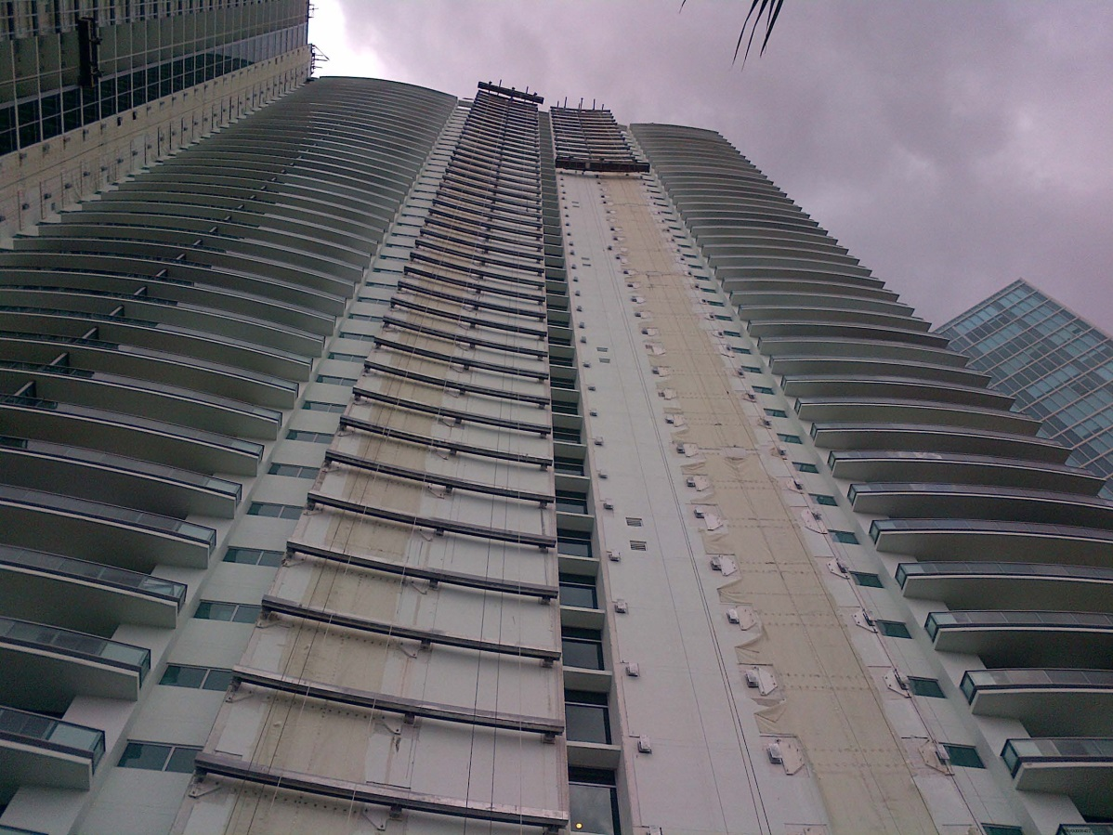

Slide 22
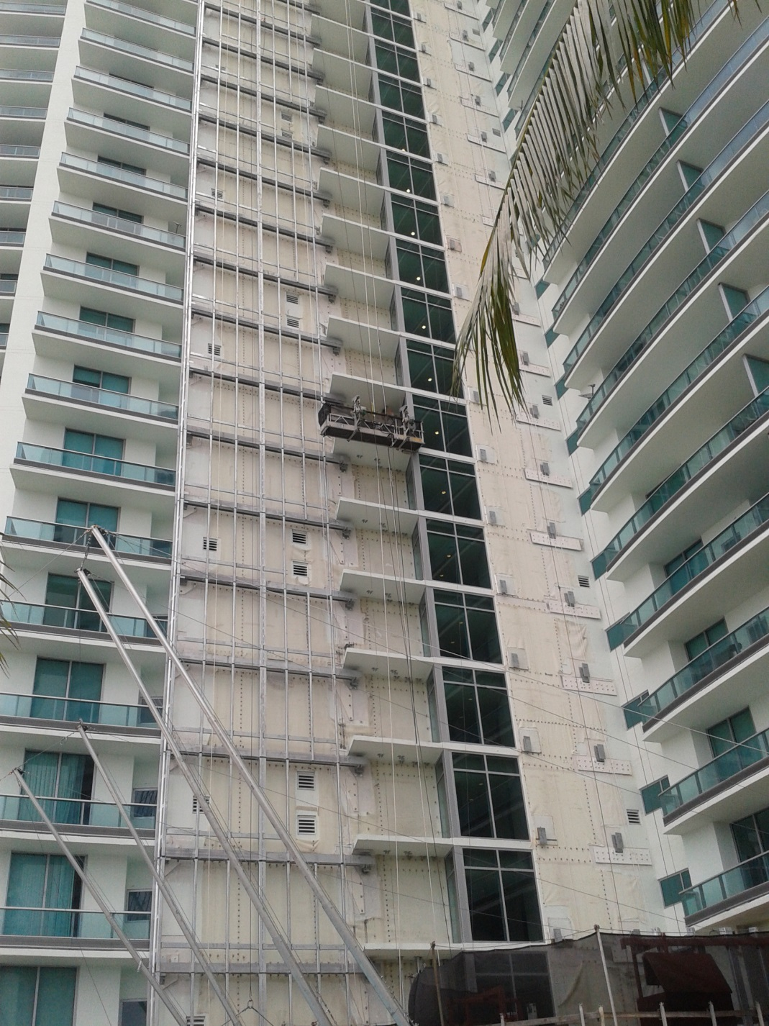
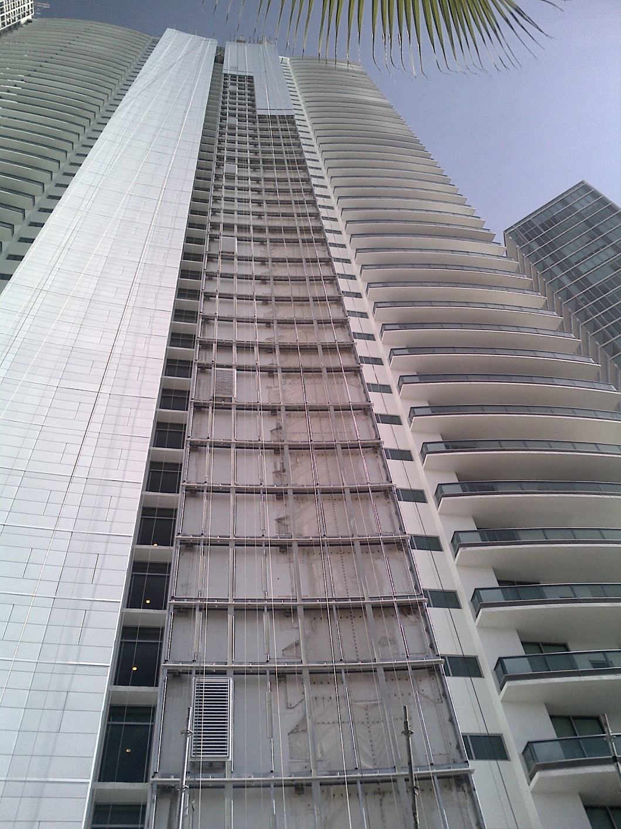

Slide 23
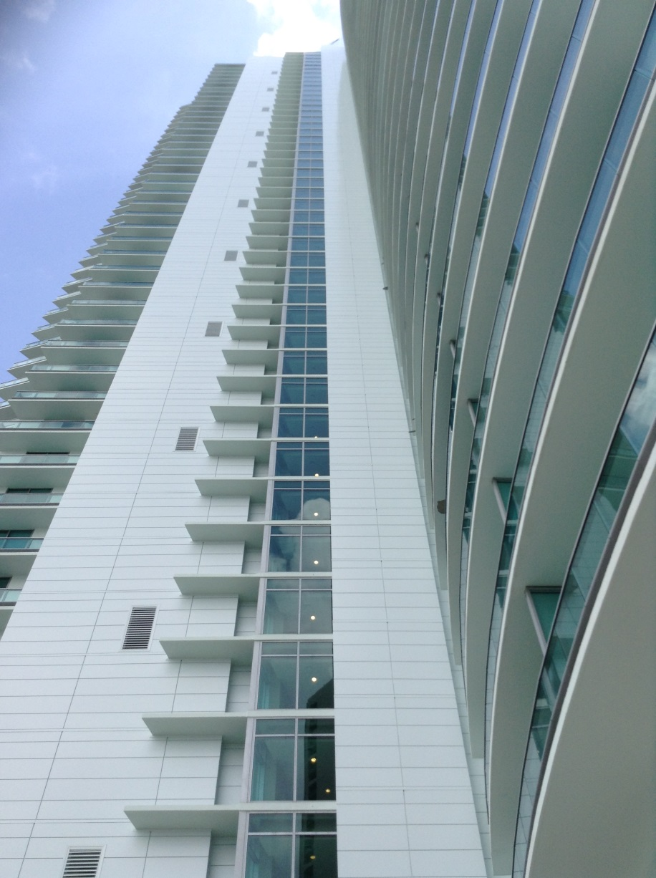
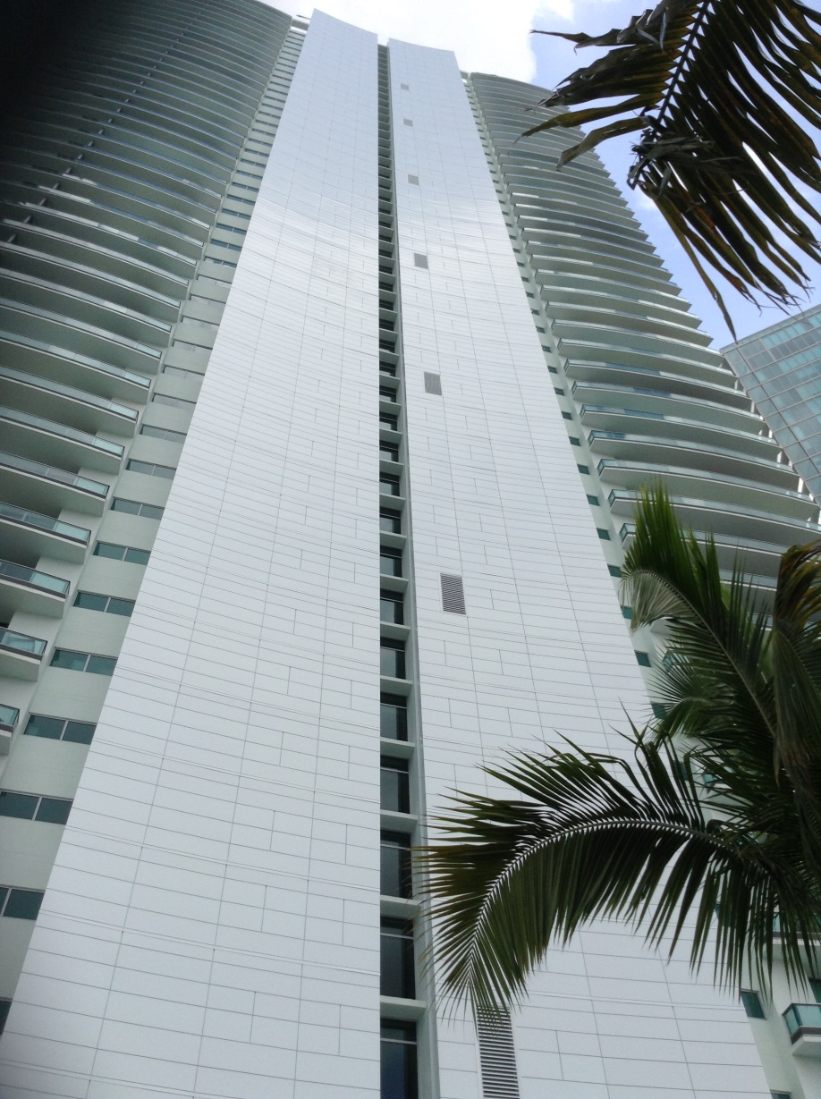

Slide 24
Subrogation Success Story:
Damages Recovered from OCIP GL Carrier
All amounts reimbursed by SDI carrier: $23.1 million
All amounts paid by GC but not reimbursed: $750,000
  Amounts submitted to SDI carrier but not yet reimbursed
  Projected remaining costs
GC’s deductible and co-payment: $950,000
Pre- and post-judgment interest: $3.2 million
Attorneys’ fees, expert fees, and costs: $1.1 million

Slide 25
Subrogation Success Story:
Impact on Florida Insurance Law
Standing for GC to pursue assigned subrogation rights
  Reduced SDI policy limits were sufficient injury
Coverage for mitigation costs under GL
  “the complete replacement of defective subcontractor work may be covered when necessary to effectively repair ongoing damage to otherwise non-defective work”
No proration of coverage between GL and SDI
  Cannot compare GL and SDI because they insure different parties and risks
  GL carriers should have paid before SDI

Slide 26
Changes in the SDI Market
Increasing number of SDI carriers
  Zurich created SDI (“Subguard”) about 25 years ago
  SDI now offered by Arch and Axa XL; other carriers considering market
Increase in large project activity and industry loss trends concerning to SDI carriers
  Limiting types of damages covered (e.g., no coverage for resulting property damage that should be covered by GL)
  Selecting projects more stringently; focusing on prequalification
  Shorter tails available (5 years or less); attempt to mirror bonds more closely
  Rates and retentions increasing

Slide 27
Takeaways
Certain risks/projects may be specifically underwritten; common exclusions may be negotiated
SDI should not be used to cover subs that cannot obtain traditional bonds (and thus are a significant default risk)
SDI allows for quicker recovery, but care must be taken to timely identify and declare a material “default” as defined by the policy
Protect SDI carrier’s subrogation rights
  Monies recovered replenish limits of the policy
  Sufficient recoveries may reimburse additional out-of-pocket losses

Slide 28
Takeaways
SDI policies are reimbursement policies
  Costs must be expended and proved before reimbursement
  Promises to pay or contingent costs create problems; may go unreimbursed
QCs should carefully document damages
  Be mindful of how costs are bucketed and set up separate cost codes for damages flowing directly from the default
    Direct costs typically subject to policy limit
    Indirect costs typically subject to sublimit (e.g., $5 million)
  SDI carriers require very detailed documentation to justify reimbursement of costs incurred (but documentation that is typically available)

Slide 29
Thank You
Eric M. Gold
eric.gold@pillsburylaw.com
Stephen S. Asay
stephen.asay@pillsburylaw.com

