Slide 1
The Drones are Coming
(with lots of insurance issues)
Edward J. Page, Carlton Fields, Tampa
FAA Certificated Manned and Unmanned Pilot and Flight Instructor
Real Property Insurance and Surety Committee
Of the Real Property, Probate & Trust Law Section of
The Florida Bar
Zoomed During the Pandemic on June 15, 2020

Slide 2

Family (Pilot) Tree

Slide 3
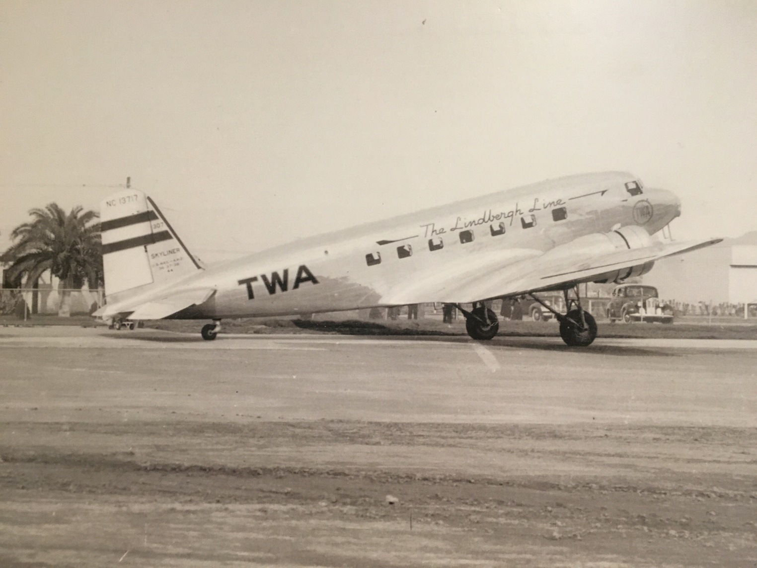
THE PAGE FAMILY AVIATION TREE IS GERMINATED
CAPT. ROY D. PAGE AND MARY LOUISE PAGE

Slide 4
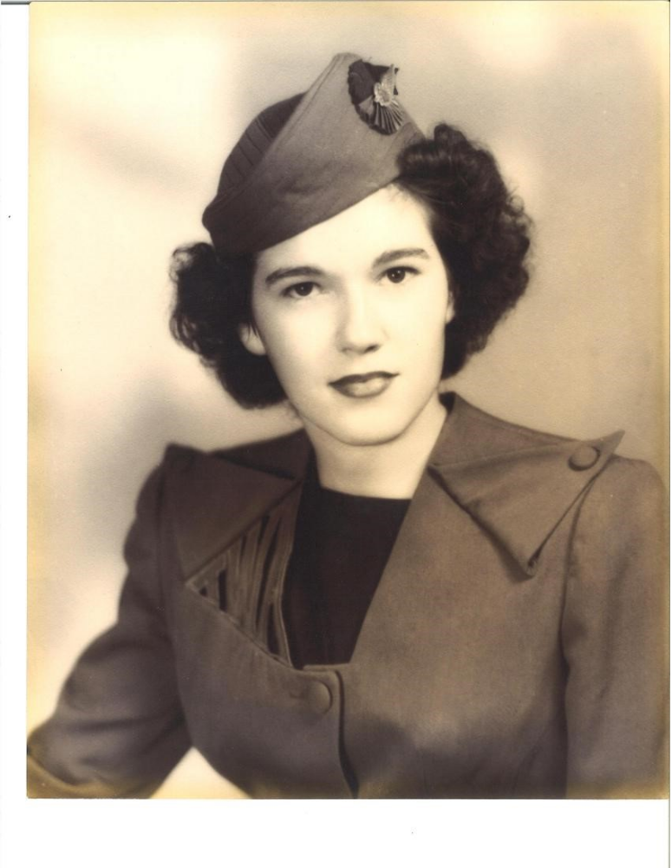
TWA FLIGHT HOSTESS

Slide 5
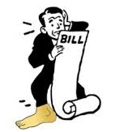
If you ever have an aviation (drone) insurance
claim, you may wish that you really paid
attention to the next few slides

Slide 6

INSURANCE

Slide 7
AVIATION PROBLEMS
EVENT
OCCURRENCE
INCIDENT
ACCIDENT

Slide 8
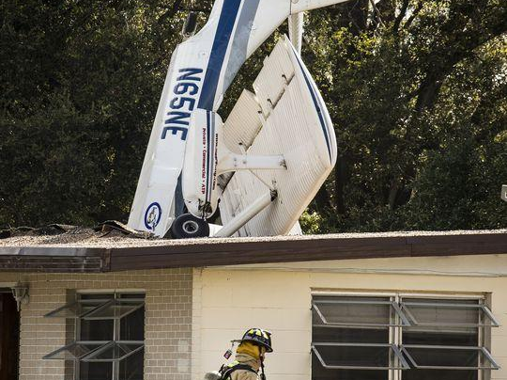
Are you insured for the contemplated flight activity?
Are you insured for the unthinkable?

Slide 9
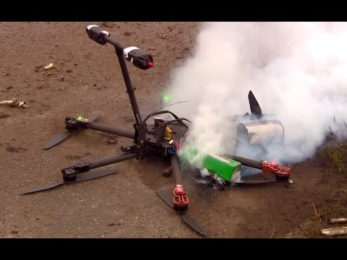
DRONES CRASH, TOO

Slide 10

Daycare Center Crash

Slide 11
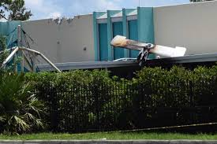
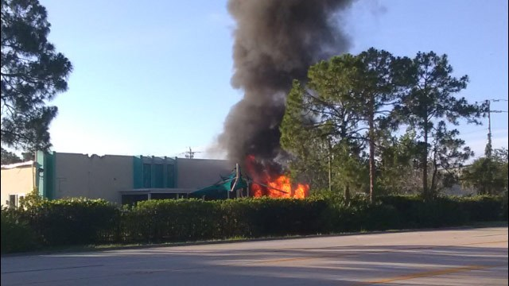
DAYCARE
CENTER
CRASH

Slide 12
Recipe for Disaster
Combine all three ingredients:
Drone
Plate glass window
Cost to replace plate glass window: $80,000
Is there enough insurance?
Was the drone pilot covered?
Was the drone pilot certificated, trained, competent, and proficient?
Who will represent me during insurance claim process?
Can that insurance company lawyer serve TWO masters?

Slide 13
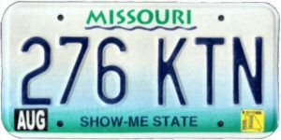
TRUST, BUT VERIFY
BEFORE FLYING,“SHOW-ME” THE AIRCRAFT INSURANCE POLICY DECLARATION PAGE AND THE INSURANCE POLICY

Slide 14
IS PILOT INSURED?
(INSIST ON DOCUMENTATION BEFORE FLYING)
AM I A NAMED INSURED?
IS MY EMPLOYER INSURED?
WITHIN SCOPE OF EMPLOYMENT?
IS THIS AN INSURED FLIGHT ACTIVITY?
HAVE INSURED’S INSURANCE REQUIREMENTS BEEN MET (SHOW ME)?

Slide 15
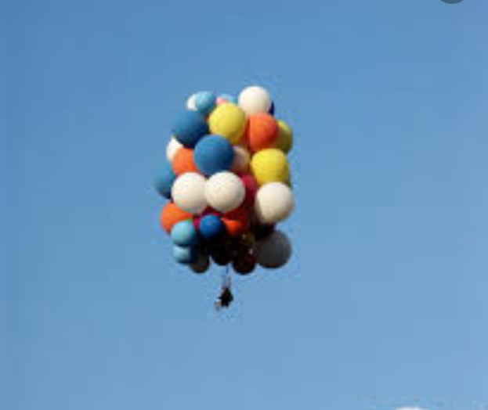
PILOT DEVIATIONS
(Pilots do interesting things)

Slide 16
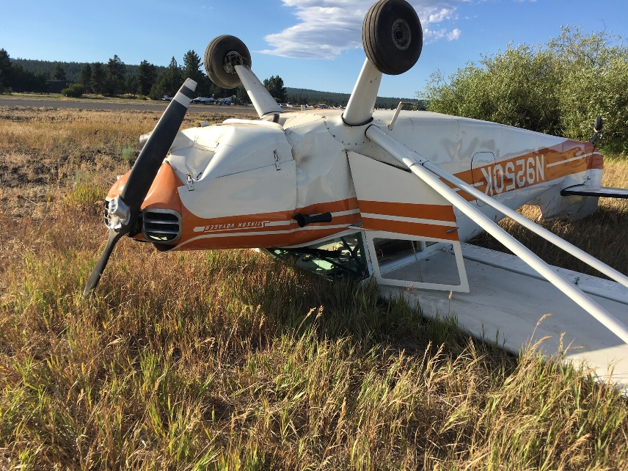
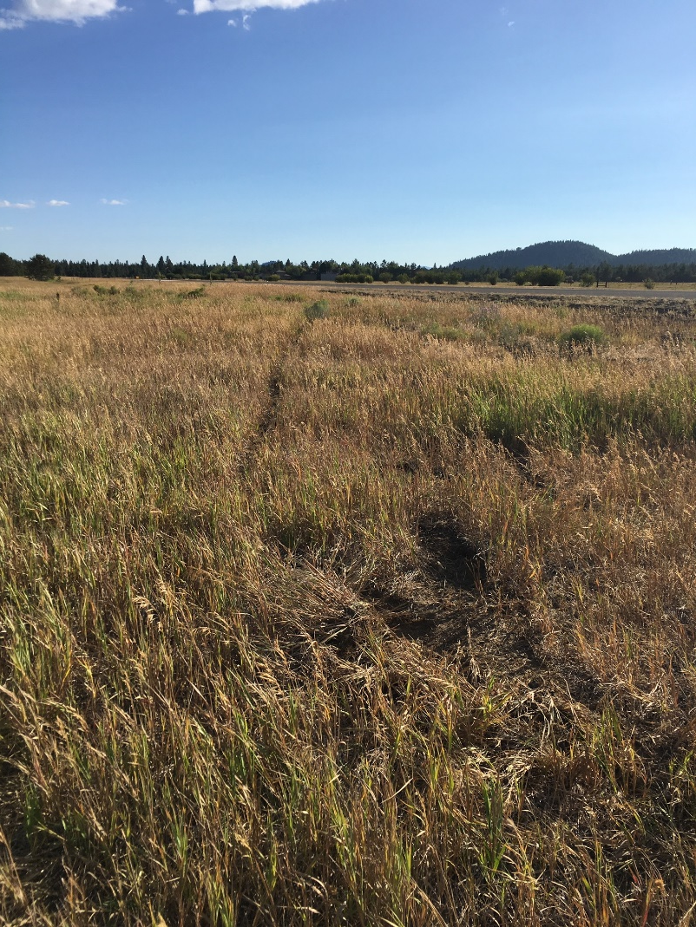
PILOT DEVIATIONS ARE FULL OF CLUES ABOUT WHAT HAPPENED

Slide 17
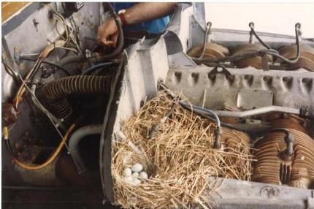
HOUSTON- WE HAVE A PROBLEM!

Slide 18
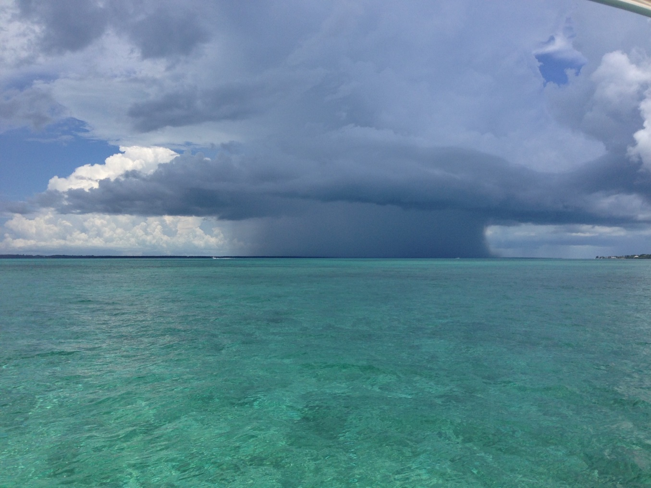
AVOID INTERESTING WEATHER

Slide 19
Car insurance cards we get every 6 months in Florida?
Aircraft Insurance card? NO
Email?
Binder
Insurance declaration page?
What do I look for?
Am I a named insured?
Is my employer insured?
Supplemental insurance?
Cut rate insurance works for pilots who think they will never need it.
Obtaining and maintaining insurance
Medical certificate good?
Medical needed for flight operation?
Annual inspection?
Logbook entries made and entered?
Current?
Flight review current?
Night landings?
IPC?
Who is PIC?
Pilot History Form
All information true and accurate?
Drone Insurance?
No night flights …
No flights over people.

Slide 20
DRONE SURVEILLANCE
FLORIDA STATUTES
934.50 Searches and seizure using a drone.
(3)(a) A law enforcement agency may not use a drone to gather evidence or other information.
(3) (b) A person, a state agency, or a political subdivision as defined in s.11.45 may not use a drone equipped with an imaging device to record an image of privately owned real property or of the owner, tenant, occupant, invitee, or license of such property with the intent to conduct surveillance on the individual or property captured in the image in violation of such person’s reasonable expectation of privacy without his or her written consent.

Slide 21
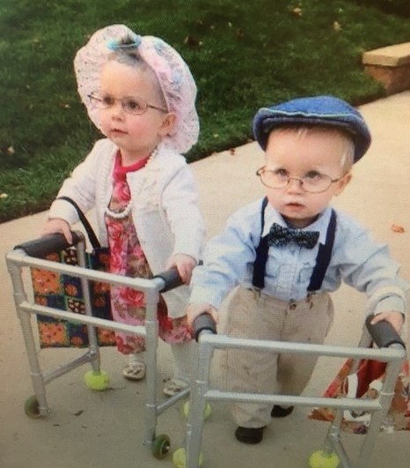
THE AGING PILOT POPULATION

Slide 22
Some Florida Drone Regulations
Florida Administrative Code 51-4.003 // 2016
This state code prohibits drones on management lands.
Town of Bonita Springs-Municipal Law // 2016
This city ordinance limits the flying of drones at Community Park in Bonita Springs.
3. City of Miami – Municipal Law // 2016
This city ordinance prevents the use of drones over or within a half-mile radius of sporting events or large-venue events.
4. City of Orlando
This city ordinance places restrictions on flying drones within 500 feet of city-owned parks, schools, and venues such as the Amway Center, Camping World Stadium and Harry P. Leu Gardens.
The University of Tampa-UAV & Drone Policy // 2015
This campus policy restricts any drone operations within or over University-owned property.

Slide 23
INTERACTING WITH THE FAA
AFTER YOUR PROBLEM
FOLLOW THE THREE DAY RULE
BE A MINIMALIST
FILE A NASA FORM EVERY TIME

Slide 24
FS 860.13 – careless or reckless
operation of AC in Florida
(and many other states).
860.13 Operation of aircraft while intoxicated or in careless or reckless manner;
It shall be unlawful for any person:
(b) to operate an aircraft in the air or on the ground or water in a careless or reckless manner so as to endanger the life or property or another.
A THIRD DEGREE FELONY IN FLORIDA

Slide 25
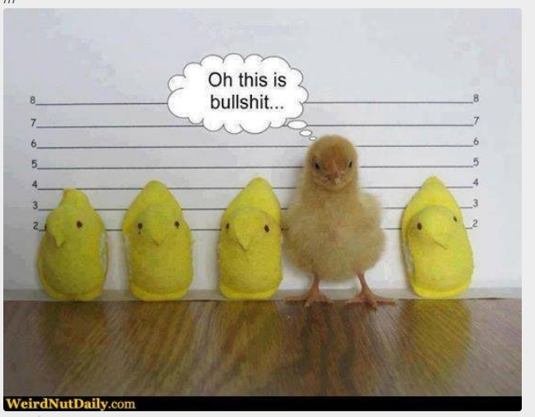
FEDERAL CRIMINAL PROSECUTION OF DRONE PILOT

Slide 26
FEDERAL CRIMINAL
AVIATION INVESTIGATIONS
Pennsylvania man charged with unlawfully operating a drone.
On September 3, 2019, a superseding indictment filed in the U.S. District Court, Philadelphia, Pennsylvania, charged Jason Muzzicato with knowingly operating an unregistered aircraft (specifically, a drone).
California man charged after he flew drone over NFL Games
On June 26, 2019, prosecutors filed an information in the U.S. District Court, San Jose, California, charging Tracy Mapes with violating national airspace regulations. He piloted over the Oakland-Alameda County Coliseum, where the Oakland Raiders were hosting the Denver Broncos.

Slide 27
DRONE INSURANCE
Boots on the Ground – Drone Insurance Claims
Drone hits a moving car
Watching a drone fly over a moving car and driver goes off the road
Drone flies over swimming pool a little too close for woman in bikini
Drone flies over horses in a corral and spooks the horses that escape
Drone hits the tail rotor of a helicopter in Los Angeles at 1,100 feet AGL
Drone crashes into an $80,000 plate glass window and breaks it
Many other examples ….

Slide 28
TWO KINDS OF INSURANCE
1. Insurance for FAA Pilot Certificate Action Against Drone Pilot
2. Insurance for Damage / Crash / Liability resulting from Drone operations
3. TAIL Insurance

Slide 29
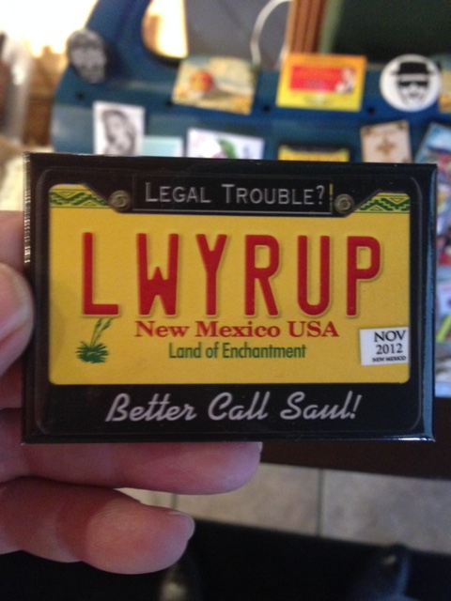
AOPA LEGAL SERVICES PLAN

Slide 30
DRONE LIABILITY INSURANCE
AIG
Old Republic
Global Aerospace
Many other insurance carriers
Drone App: Verifly

Slide 31
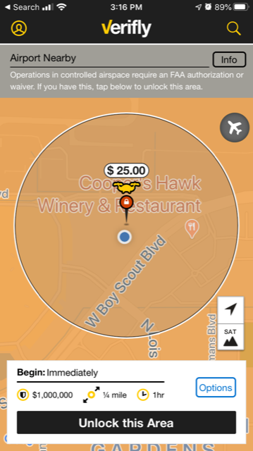
VERIFLY DRONE INSURANCE
(there’s an APP for that!)

Slide 32
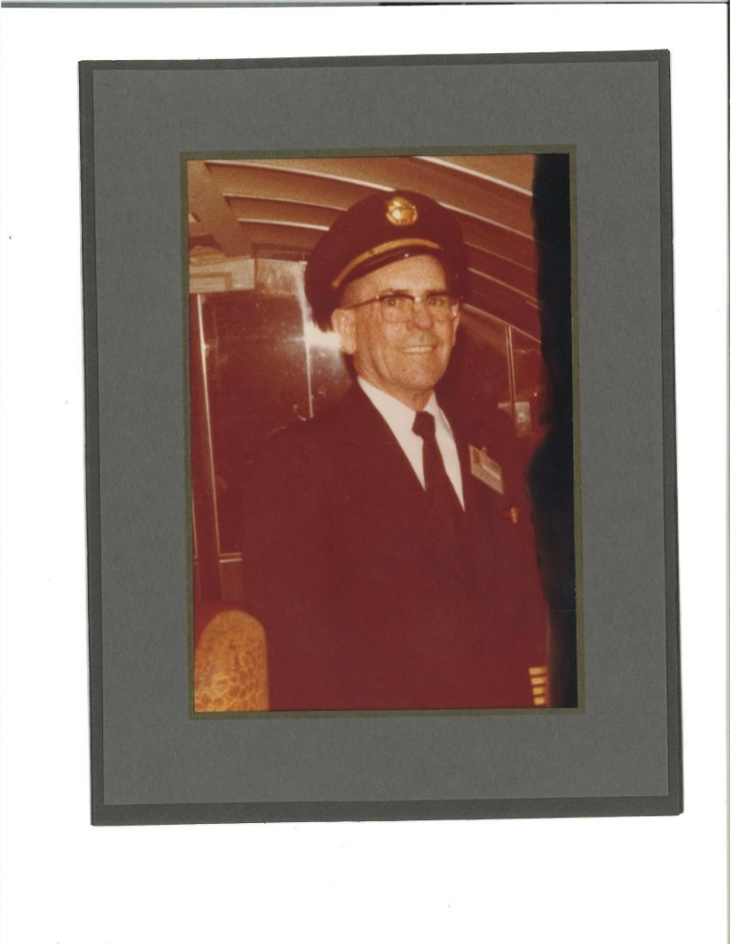
FAA Certificated Remote
Pilot vs. 747 Captain
DRONE PILOT
AIRLINE PILOT
Buy drone
Ignore FAA and other rules
Fly drone
Crash drone
Student Pilot
FAA Medical
FAA Flight training
FAA written examinations
FAA checkrides
Insurance requirements
1500 hours
ATP
“Welcome aboard… this is your captain speaking”.

Slide 33

ASTRO

Slide 34
Expose yourself and your company/employer to a negligence claim?
Are you a low risk manned or unmanned pilot?
Am I certain I am insured
Avoid risky behavior
Read and understand the applicable rules
Know policies and procedures of company/employer
No problem solving alone
Consult with others
Keep current on developments
FAA Wings Program participant
No dabbling outside your area of expertise
Careful with what you hear from others
Document important things
Log time entries with complete and accurate information
Remember, you are part of an organization
Understand and use technology
Seek first to understand, then to be understood
Listen with the intent to understand, not to reply
Do the right thing attitude

Slide 35

“My Soul is in the Sky”
William Shakespeare

