Slide 1
Florida Bar Real Property Probate Trust Law
Construction Law Committee
December 2013
Dispute Boards:
Drafting Issues
Deborah Bovarnick Mastin
Law Office of Deborah Mastin, PA
Miami, FL

Slide 2
What is a Dispute Board?
A/K/A Dispute Review Board, Dispute Resolution Board, Dispute Avoidance Board, DRB
Contractual structure for dispute avoidance and mitigation using independent panel of impartial professionals in real time
Begins at the inception of project and operates continuously during performance
Can transform into (non-binding) dispute resolution, if dispute avoidance fails

Slide 3
Why have a Dispute Board?
Mitigates impacts of activities not yet performed for the best interest of the project
Disputes don’t aggregate or compound
Validates decisions to compromise
Process cost dramatically lower

Slide 4
Creating the Dispute Board
Specification within owner-contractor Agreement
  Establish procedures
Engagement agreement between each Panel member, owner and contractor (“3-Party Agreement”)
  Establish fees, release of liability

Slide 5
Objectives of Specification
Dispute avoidance
Dispute mitigation
Facilitation & communication
Not technical advisors or mediators
Dispute resolution

Slide 6
What Makes A Panel Effective?
People
  Trust and respect for Panel
Process
  Forward-looking, problem-solving, confidential

Slide 7
People: Selection Criteria
Appropriate professional experience
Ethics
  Disclose prior relationships with parties
  Preclude new relationships during project
Available, interested, neutral, unbiased
Trained in Dispute Board practices
Mediators and arbitrators
Engineers and construction lawyers

Slide 8
Process: Training the Project Team to Succeed
Panel trains project team at first meeting to establish operating protocols and consistent expectations of panel involvement before disputes arise
Regular site visit facilitation = dispute prevention and impact mitigation
Personal connections with Panel builds confidence

Slide 9
Process: Regular Periodic Meetings
Facilitation - where the real value is gained
Monthly meetings typical
Review schedule and discuss potential disruptions
Explore in detail the “Why?” behind the numbers
Invite all stakeholders (“involved entity”)

Slide 10
Process: Informal Guidance
  Before costs incurred
  Limited presentations
  Early “quick read”
  Oral guidance offered by Panel
  de novo “formal” hearing if not accepted

Slide 11
Process: Formal Proceedings:
Choices to Make
De novo?
Non-binding or binding written report?
Admissible or Inadmissible?
Opt in or opt out?

Slide 12
Process: Formal Proceedings
Referral by either party, but only after discussion at regular meeting
Common Reference Document
Written submissions
Oral presentations - not sworn
No cross-examination
Panel questions presenters

Slide 13
Who is Using Dispute Boards?
1970s Interstate I-70 Colorado
2010 over 2200 projects > $150 B in USA
Infrastructure, tunnels, bridges, roads, dams, airports, seaports, transit, hospitals, universities
World Bank
FIDIC
ConsensusDocs

Slide 14
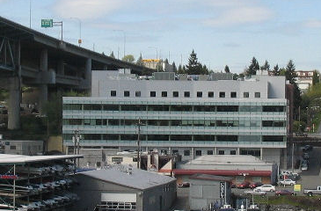
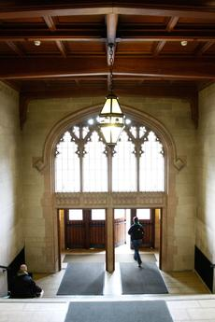
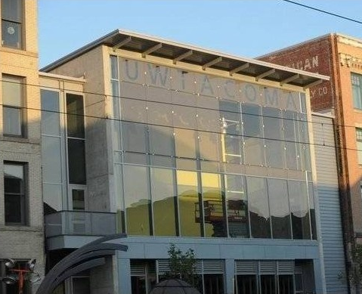
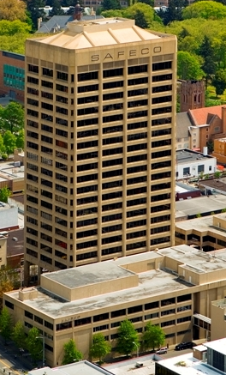
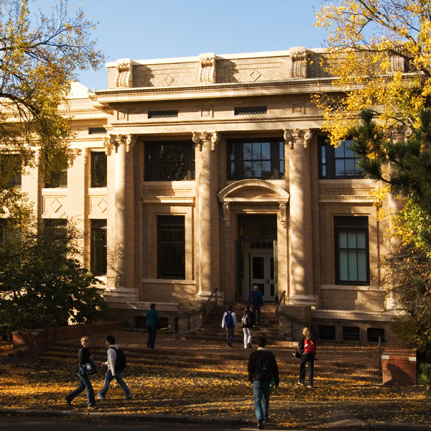
University of Washington Experience:
Since 1993 UW used Dispute Boards
    In more than 40 contracts
    Dispute Board cost < $50K each
    Total project cost > $4 Billion
    only 2 formal hearings in 20 years

Slide 15
My First 2 Dispute Boards
Arsht Performing Arts Center, Miami, Florida
Miami International Airport North Terminal Development Project

Slide 16
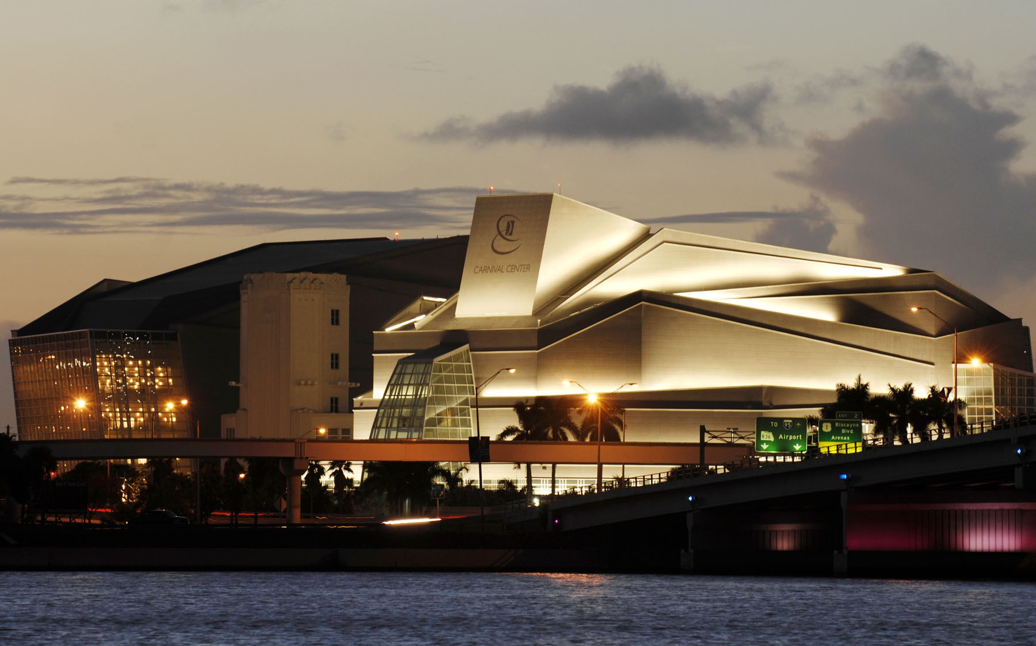
Arsht Performing Arts Center, Miami

Slide 17
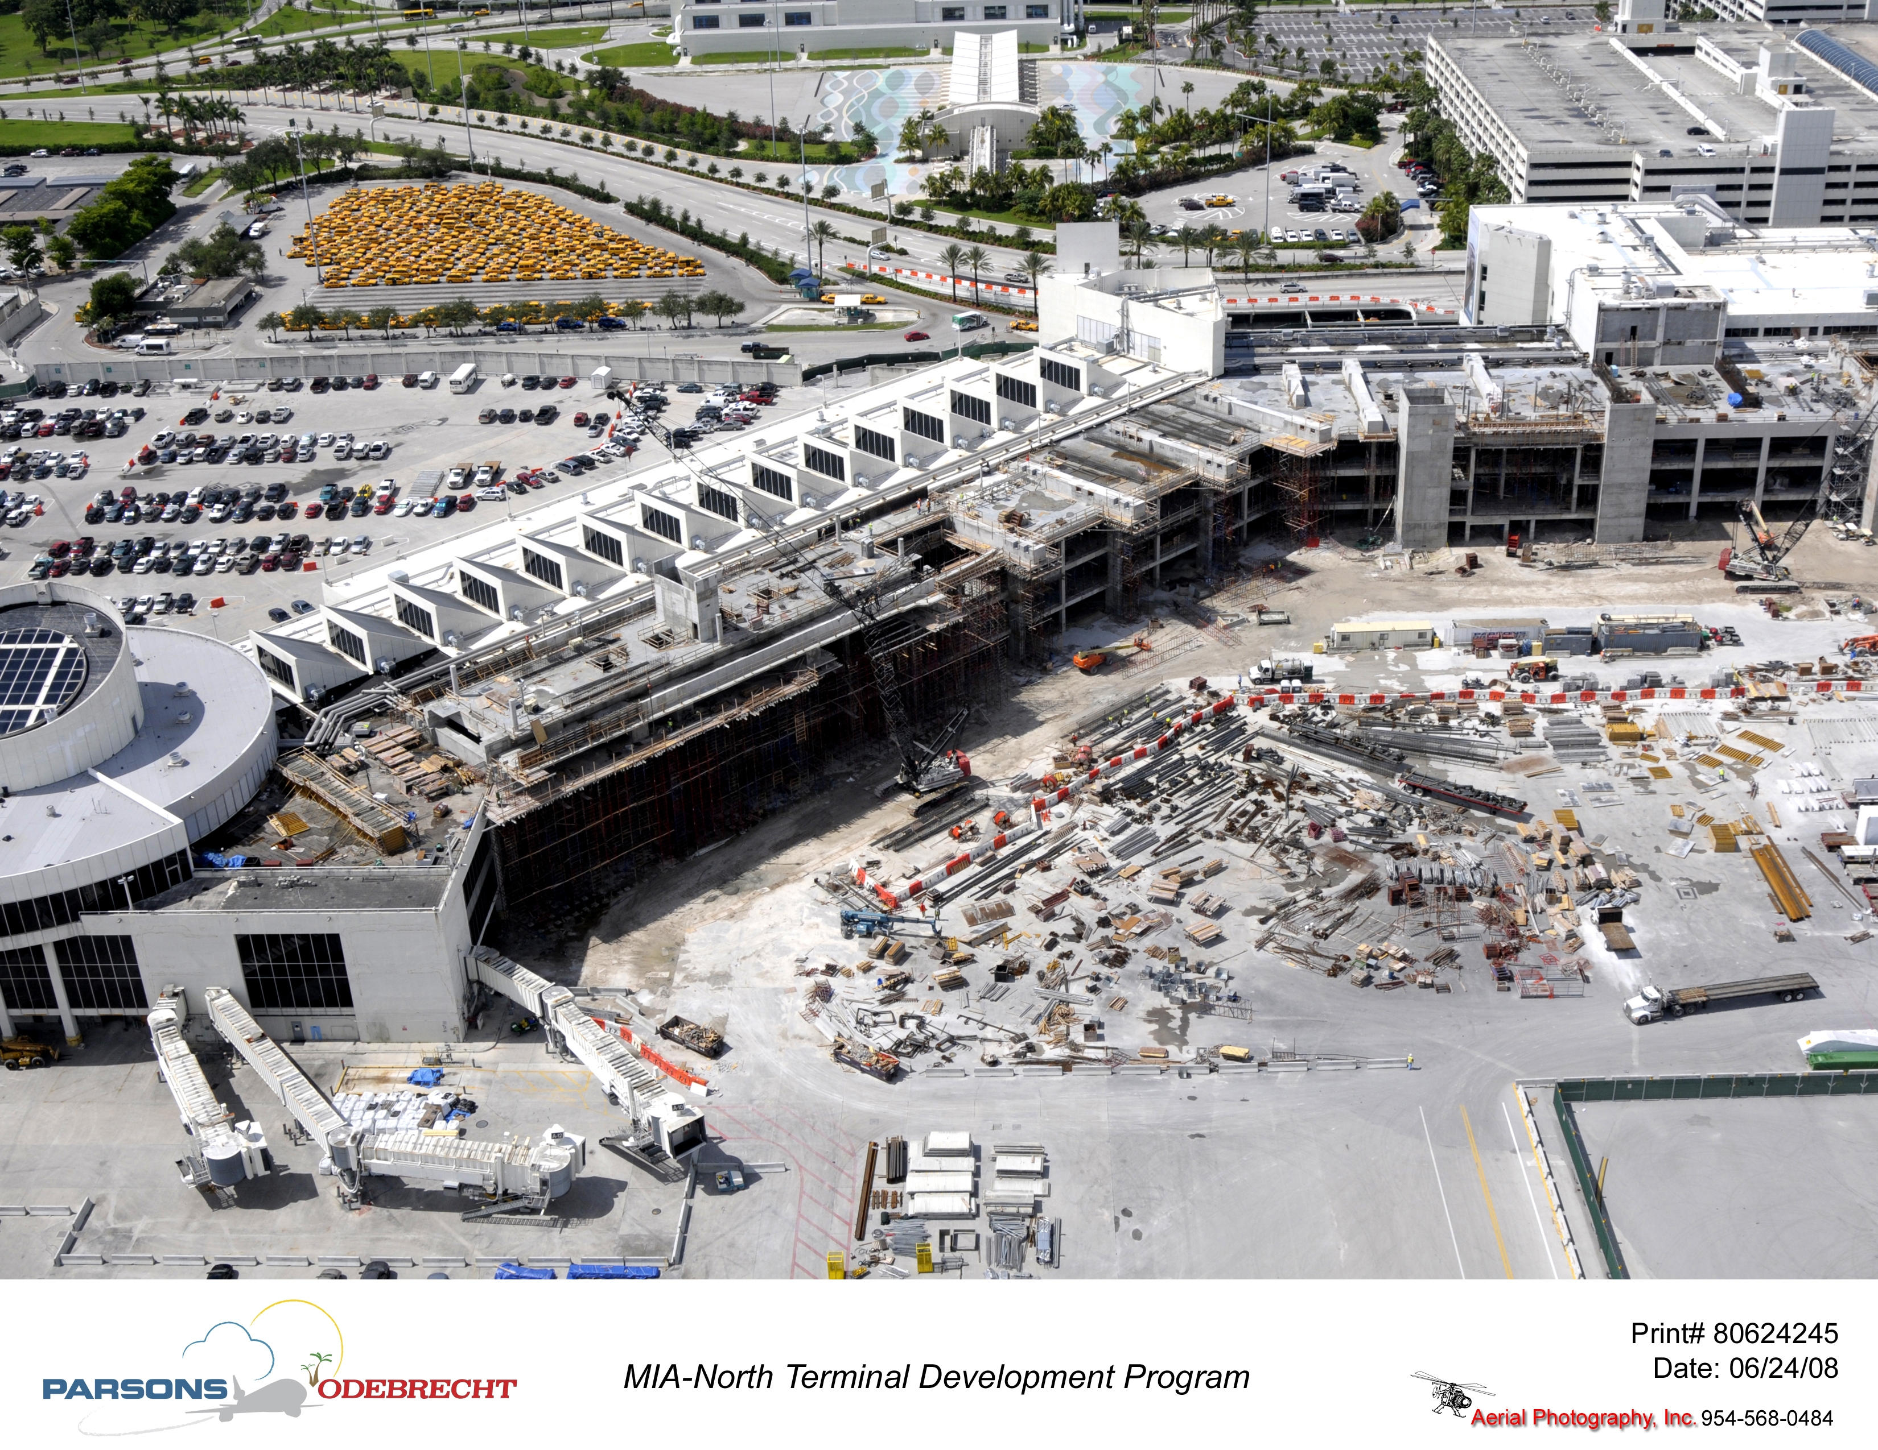
Miami International Airport

Slide 18
Drafting Take-Aways
How?
  Consider panel qualifications and selection
  Support dispute avoidance and mitigation
    Make Dispute Board start early, meet often and regularly
    Do not wait for a dispute to arise – that is too late
    Skip the steps- no preconditions to discussions
  Dispute hearings process should not mirror arbitration
  Consult existing model specifications
Why?
  Brings value to your client

Slide 19
Reference Material
Dispute Review Board Foundation: www.drb.org
ConsensusDocs: www.agc.org
American Arbitration Association: www.adr.org
International Chamber of Commerce: www.iccwbo.org
International Institute of Conflict Prevention and Resolution: www.cpradr.org
International Federation of Consulting Engineers (FIDIC): www.fidic.org
FDOT: www.dot.state.fl.us/default.shtm
Construction ADR, ABA Forum on the Construction Industry

Slide 20
Continue the conversation…
Thank you
Deborah Bovarnick Mastin
deborahmastin@gmail.com
.

