Slide 1
Top Ten Risk-Shifting Provisions in Construction Contracts
Real Property Probate & Trust Law Section
Construction Law Committee
March 9, 2015 Meeting
Scott P. Pence
Carlton Fields Jorden Burt, P.A.
spence@cfjblaw.com
813.229.4322

Slide 2
Contract - The Art of Risk and Expectation Management
Leverage
How much can I push to the other side?
Who is in the best position to assume risk?

Slide 3
Risk Shifting Provisions
Indemnification
Insurance
Liquidated Damages
Consequential Damages
Delays
Warranty/Correction Obligation
Differing Site Conditions/Hazardous Materials
Termination
Dispute Resolution
Payment Terms

Slide 4
Indemnification

Slide 5
Indemnification Continuum
Intermediate Form (“in whole or in part” by Indemnitor)
Common Law Indemnification
Limited Form
(to the extent of Indemnitor’s negligence)
Broad Form (sole negligence of Indemnitee)

Slide 6
Indemnification: Issues
Form
  Limited (to the extent of party’s negligent acts or omissions)
  Intermediate (at least partly at fault)
  Broad (even if no fault)
Personal Injury & Property Damage (insurance)
Breach of contract or other types of claims
Infringement Claims (not if part of a required design, process or product or where infringement is part of documents prepared by owner or designer)

Slide 7
Florida Statutes §725.06
Construction contracts; limitation on indemnification (1) Any portion of any agreement … in connection with … any construction, alteration, repair, or demolition of a building, structure, appurtenance, or appliance … between an owner of real property and an architect, engineer, general contractor, subcontractor, sub-subcontractor, or materialman or any combination thereof wherein any party referred to herein promises to indemnify or hold harmless the other party to the agreement … for liability or damages to persons or property caused in whole or in part by any act, omission, or default of the indemnitee arising from the contract or its performance, shall be void and unenforceable unless the contract contains a monetary limitation on the extent of the indemnification that bears a reasonable commercial relationship to the contract …

Slide 8
Florida Statutes §725.06
…Indemnification provisions in any such agreements, contracts, or guarantees may not require that the indemnitor indemnify the indemnitee for damages to persons or property caused in whole or in part by any act, omission, or default of a party other than:
  (a) The indemnitor;
  (b) Any of the indemnitor's contractors, subcontractors, sub-subcontractors, materialmen, or agents of any tier or their respective employees; or
  (c) The indemnitee or its officers, directors, agents, or employees. However, such indemnification shall not include claims of, or damages resulting from, gross negligence, or willful, wanton or intentional misconduct of the indemnitee or its officers, directors, agents or employees, or for statutory violation or punitive damages except and to the extent the statutory violation or punitive damages are caused by or result from the acts or omissions of the indemnitor or any of the indemnitor's contractors, subcontractors, sub-subcontractors, materialmen, or agents of any tier or their respective employees.

Slide 9
Florida Statutes §725.06
(2) A construction contract for a public agency or in connection with a public agency's project may require a party to that contract to indemnify and hold harmless the other party to the contract, their officers and employees, from liabilities, damages, losses and costs, including, but not limited to, reasonable attorney's fees, to the extent caused by the negligence, recklessness, or intentional wrongful misconduct of the indemnifying party and persons employed or utilized by the indemnifying party in the performance of the construction contract.
(3) Except as specifically provided in subsection (2), a construction contract for a public agency or in connection with a public agency's project may not require one party to indemnify, defend, or hold harmless the other party, its employees, officers, directors, or agents from any liability, damage, loss, claim, action, or proceeding, and any such contract provision is void as against public policy of this state.
(4) This section does not affect any contracts, agreements, or guarantees entered into before the effective date of this section or any renewals thereof.

Slide 10
Insurance

Slide 11
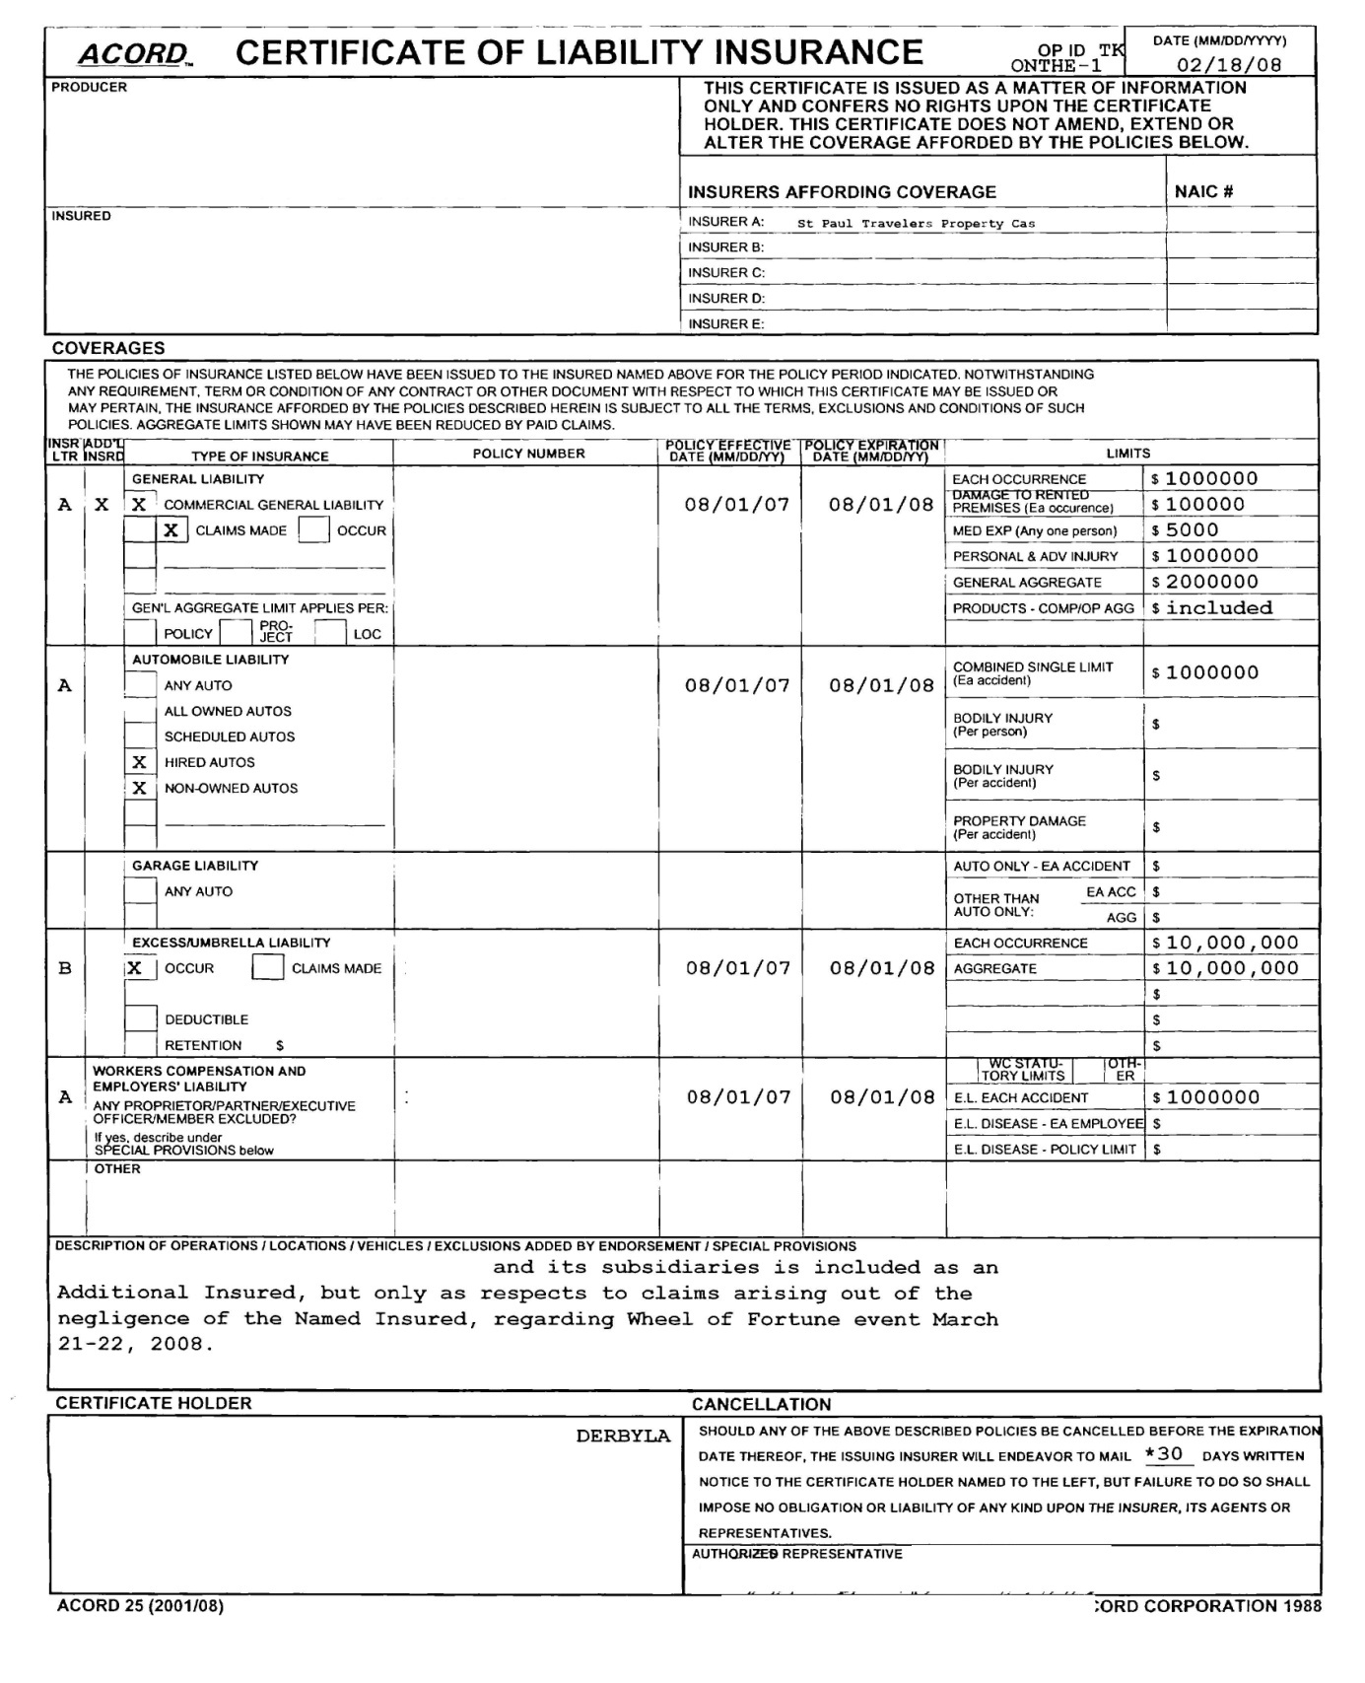

Slide 12
ACORD Certificate of Insurance
Issued as a matter of information only
Does not amend terms of policy
Does not constitute a contract
Policies have been issued for the period indicated
Subject to all terms, exclusions and conditions of the policies
Bottom Line: MUST OBTAIN AND REVIEW POLICIES AND/OR APPROPRIATE ENDORSEMENTS BECAUSE CERTIFICATE OF INSURANCE NOT BINDING

Slide 13
Additional Insured
Obtain the same benefit as the insured with respect to defense of suit and coverage issues
Assure that indemnification obligations are funded
  Broad form
  Intermediate form
  Limited form

Slide 14
OLD ISO Additional Insured Endorsements
COMPLETED OPERATIONS & ONGOING OPERATIONS/BROAD FORM
  CG 20 10 11 85 (“arising out of”)
COMPLETED OPERATIONS/BROAD FORM
  CG 20 37 10 01 (“arising out of”)
ONGOING OPERATIONS/BROAD FORM
  CG 20 10 10 01 (“arising out of”)
COMPLETED OPERATIONS/INTERMEDIATE FORM
  CG 20 37 07 04 (“in whole or in part”)
ONGOING OPERATIONS/INTERMEDIATE FORM
  CG 20 10 07 04 (“in whole or in part”)

Slide 15
2013 ISO Additional Insured Endorsements
COMPLETED OPERATIONS
  CG 20 37 04 13
ONGOING OPERATIONS
  CG 20 10 04 13
Only to the extent permitted by law.
If coverage provided to the additional insured is required by a contract or agreement, the insurance afforded to such additional insured will not be broader than that which you are required by the contract or agreement to provide for such additional insured.
If coverage provided to the additional insured is required by a contract or agreement, the most we will pay on behalf of the additional insured is the amount of insurance: (1) required by the contract or agreement; or (2) available under the applicable Limits of Insurance shown in the Declarations; whichever is less.

Slide 16
Practice Points
Each party should verify that coverages were obtained by getting copies of applicable endorsements and possibly underlying policies
Understand the indemnification obligations and procure the appropriate insurance (and endorsements)
Get consultant/agent/risk manager involved as early as possible

Slide 17
Insurance: Issues
Certificate of Insurance (cannot rely upon)
Insurance Consultant/Advisor (coverages and limits)
May have to pay for additional coverage
Additional Insured
Notice of Cancellation (need endorsement)
Property Insurance – “no fault” terms (waiver of subrogation (for all property insurance), waiver of loss of use, deductibles, change order)
Exhibit?

Slide 18
Liquidated Damages

Slide 19
Liquidated Damages: Issues
Difficulty in determining
Reasonable Estimate (no penalty)
Tied to Substantial Completion/Final Completion
Owner’s sole and exclusive remedy
Milestones
Tiered?
Cumulative Cap?
Early Completion Bonus?

Slide 20
Consequential Damages

Slide 21
Consequential Damages: Issues
Owner usually more likely to incur
Potentially crippling to contractor (“bet the company”)
Carve-outs
  Insurance proceeds
  Willful misconduct or gross negligence
  % of fee / $ amount
  Not for indemnification (effectively nullifies waiver)
Probably uninsurable

Slide 22
Delays

Slide 23
Delays: Issues
No-Damage-For-Delay provisions generally enforceable in Florida
Judicial Exceptions
  Active or Intentional interference
  Delay lasting longer than a time period for which the parties would have reasonably contemplated
Modified
  Timeframe
  Monetary limitation
Force Majeure
  Unforeseeable
  Beyond Party’s Control
  Scope/Causes

Slide 24
Warranty/Correction Obligation

Slide 25
Warranty/Correction Obligation: Issues
Warranty
  Good quality/new unless otherwise required or permitted
  Conformance with the Contract Documents
  Free from defects except those inherent in quality required or permitted
Commence upon achievement of Substantial Completion
Standard exclusions (e.g. normal wear and tear, misuse, damage by others, etc.)
Implied/Statutory warranties (merchantability, fitness for a particular use, condominiums)
Correction obligation
  Separate obligation
  Notice from Owner
  No extension for repairs
  Timeframe (e.g. 12 months, 24 months, etc.)

Slide 26
Differing Site Conditions/Hazardous Materials

Slide 27
Differing Site Conditions: Issues
Both Types:
  Subsurface or otherwise concealed physical conditions differing materially from those indicated in Contract
  Unknown Physical Conditions of an unusual nature differing materially from those generally recognized as inherent in construction of the type covered by Contract
Reasonable timeframe for notice
Process/Investigation (by Owner)
Adjustment to Contract Sum and/or extension to Contract Time (for delays, etc.)

Slide 28
Hazardous Materials: Issues
Process (stop work, provide notice, Owner investigates and remediates, contractor recommence after proper adjustments to comp. and/or time)
Indemnifications from Owner
  Pre-existing haz/mat
  Govt. agency brings contractor into suit solely because it was performing work at the site
Adjustment to Contract Sum and/or extension of Contract Time
Owner liable for pre-existing haz/mats
Contractor indemnifications
  Haz/mat brought onto site and negligently handled
  Failure to comply with process

Slide 29
Termination

Slide 30
“T for C” Issues
Remedies/Damages
  Work performed
  Costs incurred as a result
  Pre-ordered/Fabricated Materials
  Lost profits or a termination fee
  Possibly a schedule set up on a sliding scale
    Sliding scale intended to mitigate against owner terminating as soon as contractor has bid out all the work

Slide 31
“T for D” Issues
Written notice
  Reasonable timeframe
  Follow up notice before terminating?
Opportunity to cure
  Reasonable period of time
  Commence and diligently continue if unable to cure immediately
Limitation of remedies?
Owner’s Additional costs and expenses to replace
All common law rights if silent
  Anticipated profits for wrongful termination
Bridge/Conversion Clause?

Slide 32
Dispute Resolution

Slide 33
Dispute Resolution: Issues
Binding Dispute Resolution
  Litigation
  Arbitration
  Other?
Tiered Approach (i.e. non-binding methods)
  Negotiation between project managers
  Negotiation between executives with decision making power
  Non-binding mediation (identify mediator in contract?)
Venue
Jurisdiction
Consolidation and Joinder
Prevailing Party’s Attorneys’ Fees Provision
Waiver of Jury Trial
Consistency among various documents
  Owner - GC/Arch/Consultants
  GC/Arch/Consultants – Subs

Slide 34
Payment Terms

Slide 35
Payment Terms: Issues
Reasonable timeframe / Milestones
Waivers and Releases of Liens
  Only required to provide statutory forms
  Broader form enforceable if agreed to provide
Right to stop performance if not paid
Retainage
  Reasonable percentage
  Reduction and Early Release
    upon 50% completion/substantial completion
    Release as top subs that have completed their work
Late Payment Interest Rate
Waiver of Rights Upon Final Payment
  Owner waives all claims except for liens, latent defects, and warranty issues
  Contractor waives all claims “except those previously made in writing and identified as unsettled at the time of final Application for Payment”

Slide 36
Thank You – Questions?
Scott P. Pence
Carlton Fields Jorden Burt, P.A.
spence@cfjblaw.com
813.229.4322

