Slide 1

The Interplay of
Additional Insured Coverage &
Construction Contract Terms
Florida Bar RPPTL Section ~ Real Property Law Division Construction Law Committee
Webinar CLE
Monday, September 12, 2016
David A. Zulian
DAZulian@NaplesLaw.com
Debbie Sines Crockett
DSCrockett@NaplesLaw.com
CHEFFY PASSIDOMO
ATTORNEYS AT LAW
Tampa, FL

Slide 2
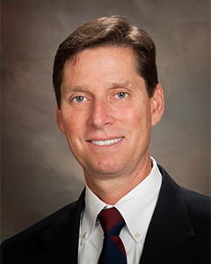
DAVID A. ZULIAN is board certified by the Florida Bar as a specialist in Construction Law, and is an experienced trial lawyer who concentrates his practice in the areas of construction, real estate, and commercial litigation. His client base is diverse and includes the representation of manufacturers, suppliers, distributors, subcontractors, general contractors, developers, design professionals, owners, lenders, mortgage brokers, real estate brokers, condominium associations, mobile home associations, and homeowners associations.
David has extensive experience in dealing with cases involving insurance for construction defects, construction defects, Florida’s Construction Lien Law, and Florida’s Public Bond Law. In 1995, he was the first attorney in the State of Florida to successfully try and appeal a case involving Florida’s Prompt Payment Law in connection with a public project. In addition, David has lectured in the areas of construction, commercial law, and insurance. In 1989, he became certified as a court arbitrator by the Florida Dispute Resolution Center. Formerly, David was the President of the American Concrete Institute, Florida Gulf Chapter. Among many other memberships, notably David is a member of the Hillsborough County Bar Association Construction Law Section and of the Florida Bar’s RPPTL Section.
David is a graduate of Emory University (B.A. 1983) and received his law degree from the University of Miami School of Law (J.D. 1987). He was formerly associated with and a partner in the law firm of Ruden, McClosky, Smith, Schuster & Russell, P.A. In 2001, Mr. Zulian joined Cheffy Passidomo as a shareholder and principal. David is a member of The Florida Bar and the New Jersey Bar.
CHEFFY PASSIDOMO
ATTORNEYS AT LAW

Slide 3
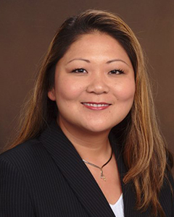
Debbie Sines Crockett is a trial lawyer with Cheffy Passidomo, P.A. in Tampa, Florida, where she concentrates in the areas of insurance coverage, commercial disputes, and construction litigation. Debbie is experienced in representing policyholders of all types of insurance policies in litigation against carriers from the trial level through appeal, in both state and federal courts. She has an emphasis in assisting clients with complex insurance related issues such as additional insured status, contractual indemnity, and risk management counseling. Debbie’s practice includes all aspects and types of insurance recovery, including insurance denials, claim representation, and both first and third party bad faith/extra-contractual claims.
Among many other memberships, notably Debbie serves as the Co-Chair of the Insurance Law Committee of the National Asian Pacific American Bar Association, is on the board of the Asian Pacific American Bar Assoc. of Tampa Bay, is a member of the ABA Tort Trial & Insurance Practice Section, is a member of the Hillsborough County Bar Association Construction Law Section, and is a member of the Florida Bar’s RPPTL Section. She has presented insurance law related CLEs locally and nationally, and most recently presented a 2-part series to the HCBA Construction Law Section titled “Insurance Overview for Construction Lawyers - Part 1: Contracts to 558 Notice” and “Part 2: Claim, Correspondence and Conclusion.”
Debbie is a graduate of Salisbury University (B.A. 1996), and received her law degree from the University of Baltimore School of Law (J.D. 1999). Just prior to joining Cheffy Passidomo, P.A., Debbie was an equity partner in the law firm of Boyle, Gentile, Leonard and Crockett, P.A. in Fort Myers, Florida. Debbie is licensed to practice law in Florida and Maryland.

Slide 4




OWNERS
Carriers
Contractors
Condo Asso.

Slide 5

Why am I here? I didn’t do anything wrong!
Design Prof
Developer
Sub
Sub
GC

Slide 6




Slide 7
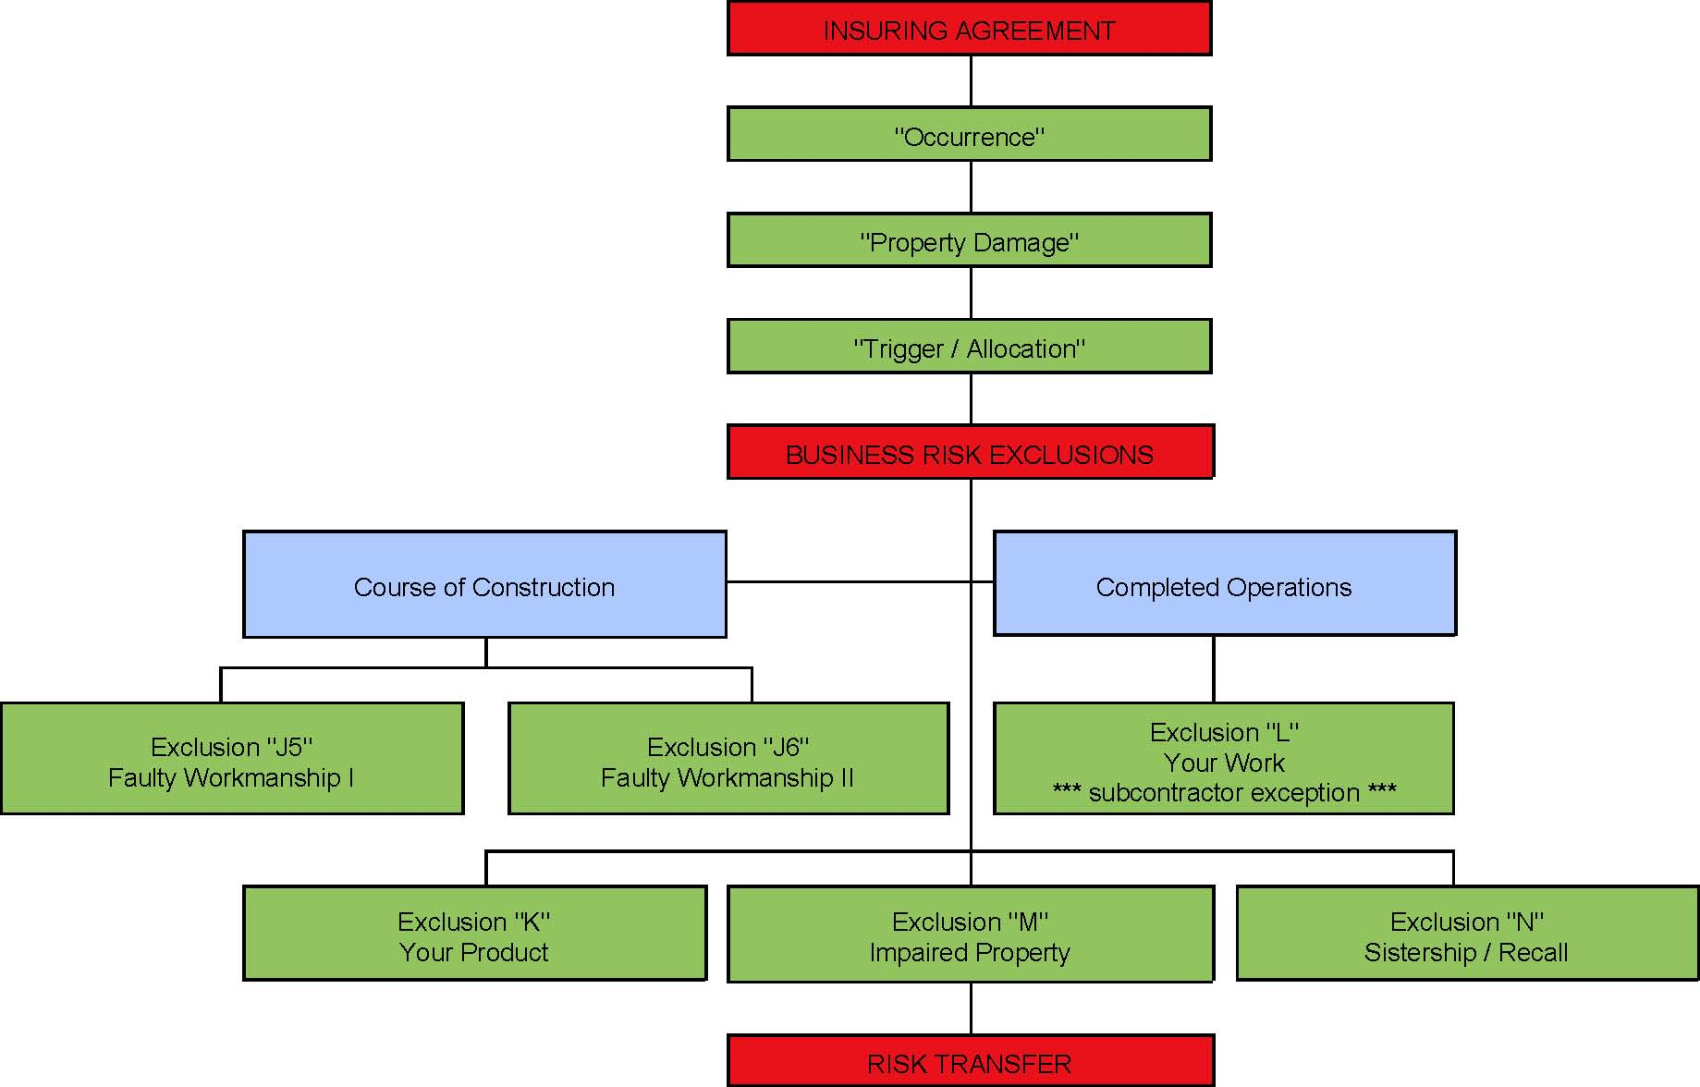
Analysis Flowchart for CGL Policies
The Contracts

Slide 8
Common Policy Exclusions
Breach of K
Mold
Known Loss / Continuous Injury or Damage
Earth Movement, Ground Collapses, Explosions, Underground
Absolute Pollution & Total Pollution
Contractual Indemnity
Multiple Stories – 3+ stories
Roofing work
EIFS & Stucco
Residential Construction
Condominium / Apartments / Multi-Unit Dwellings
j.(5) & j.(6) “during operations”
k. “your product”
l. “your work”
m. “impaired property”
n. “withdrawn or recalled from the market or from use

Slide 9
The Your Work Exclusion (l)
U.S. Fire Ins. Co. v. J.S.U.B., Inc., 979 So.2d 871 (Fla. 2007)
The 1986 Form
This insurance does not apply to:
l. “Property damage” to “your work” arising out of it or any part of it and included in the “products-completed operations hazard.”
This exclusion does not apply if the damaged work or the work out of which the damage arises was performed on your behalf by a subcontractor.
The Subcontractor Exception
to the
“Your Work” Exclusion (l)!!
Notes:
DAZ

Slide 10
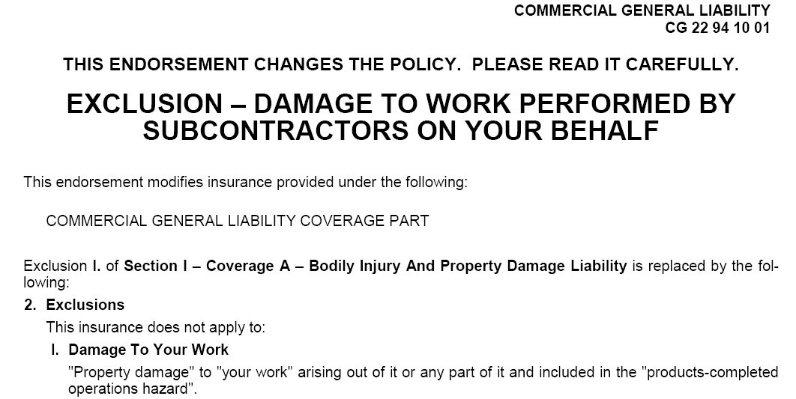
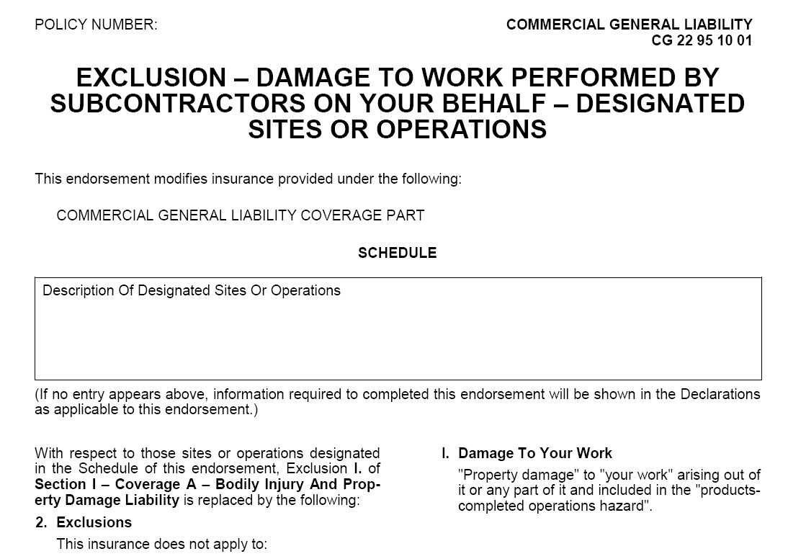
Endorsements Designed to Eliminate the Subcontractor Exception to Exclusion (l)
Tip #1
CG 22 94 10 01
CG 22 95 10 01
Notes:
DAZ

Slide 11
Analysis Flowchart for CGL Policies
The Contracts

Slide 12

Shifting the Risk
2 Ways to Shift the Risk
Contractual Indemnity
Additional Insured
Notes:
DAZ

Slide 13
Shifting the Risk: Contractual Indemnity
  Transfers the risk downstream
    Owner to GC
    GC to Sub
    Sub to Sub-Sub
  Contract provision that requires one party to indemnify, hold harmless and sometimes defend the other
  Owner/GC shifts liability to Sub
  Florida Statute §725.06
Notes:
DAZ

Slide 14
Shifting the Risk: Contractual Indemnity
SUBCONTRACT
Requires
Indemnity
Enforcing the SubContract
GC
(INDEMNITEE)
SUB
(INDEMNITOR)
Coverage for the GC as Indemnitee
GC’s CGL Policy
SUB’s
CGL Policy
  Insurance DOES NOT = Indemnification
Notes:
DAZ

Slide 15
Shifting the Risk: Contractual Indemnity
  Insurance Coverage under Sub’s CGL for
  the GC as an Indemnitee
  v.
  GC’s Enforcement of the SubContract Against Sub

Slide 16
Tip #2
Shifting the Risk: Contractual Indemnity
The Subcontract
Indemnity for Sub’s sole negligence? Florida Statute §725.06
Is the Sub required to defend the GC, too?
Contemporaneously | Reimbursement
- “As you go” & from the beginning | - After indemnification obligation is established
Drafting Tips: - “indemnify, defend, and hold GC harmless” - “Sub’s duty to defend under this paragraph is independent and separate from its duty to indemnify and hold harmless, and the duty to defend exists regardless of any ultimate liability of GC and/or any Indemnified Party. The duty to defend arises immediately upon presentation of a Claim by any person or entity with written notice of such Claim being provided to Sub.” | “Indemnify and hold harmless” Or “Indemnify, defend, and hold harmless

Slide 17
The Sub’s CGL Policy
Shifting the Risk: Contractual Indemnity
Q: Does the Sub’s policy cover the its indemnity obligation?
A: Coverage is usually built in to standard CGLs, but policy may not cover all risks shifted through indemnification. Coverage for the indemnity claim turns on whether the indemnity agreement is an “Insured Contract” as defined by the Sub’s CGL
Contractual Liability Exclusion
“Bodily injury” or “property damage” for which the insured/Sub is obligated to pay damages by reason of the assumption of liability in a contract or agreement. This Exclusion does not apply to liability for damages:
“That the insured [Sub] would have in the absence of the contract or agreement” = liability resulting from the fault of the insured [Sub].
“assumed in a contract or agreement that is an ‘insured contract’, provided the bodily injury or property damage occurs subsequent to the execution of the contract or agreement”

Slide 18
The Sub’s CGL Policy
Shifting the Risk: Contractual Indemnity
“Insured Contract” = a contract in which the insured/Sub assumes the tort liability of another party. Tort liability means a liability that would be imposed by law in the absence of any contract or agreement.
Thus, to qualify as an “Insured Contract, it must:
Pertain to the Sub’s/insured’s business
Entered into before the underlying liability/tort occurs
Assume the tort liability of another
Not violate anti-indemnity statutes

Slide 19
The Sub’s CGL Policy
Shifting the Risk: Contractual Indemnity
Q: Is the Sub’s contractual obligation to defend the GC covered?
A: What does Sub’s Policy say?
“We will have the right and duty to defend any “suit”….”
“We will have the right and duty to defend the insured against any “suit”….”
  Q: If the Sub’s contractual obligation to defend the GC is covered, must the Sub’s carrier defend the GC Contemporaneously?
  A: Read the Supplementary Payments Provision.
  Supplementary Payments do not reduce available policy limits, but for indemnitees it may be more limited.
  If the Sub’s carrier chooses to defend GC as an indemnitee, these payments do reduce available policy limits.

Slide 20
Shifting the Risk
2 Ways to Shift the Risk
Contractual Indemnity
Additional Insured
Notes:
DAZ

Slide 21
Shifting the Risk: Additional Insured
  Transfers the risk downstream
    Owner to GC (but not Builder’s Risk)
    GC to Sub
    Sub to Sub-Sub
  Contract provision that requires one party to provide insurance coverage to the other
  Owner shifts liability to GC’s CGL policy
  GC shifts liability to Sub’s CGL policy
Notes:
DAZ

Slide 22
Shifting the Risk: Additional Insured
SUBCONTRACT
Requires
GC be named as an
Additional Insured
GC
(ADDITIONAL INSURED)
SUB
(NAMED INSURED)
GC’s CGL Policy
SUB’s
CGL Policy
(GC’s AI Policy)
Notes:
DAZ

Slide 23
Shifting the Risk: Additional Insured
Shifts the risk to the party undertaking the activities
  GC shifts risk to the Subs
Reinforces indemnity provision
Provides AI Direct Rights under the Sub’s/AI policy
AI has right to Contemporaneous Defense
  Supplementary Payments Provision
    These payments do not reduce available policy limits
Added as AI by Blanket or by Schedule
  Blanket – Any person or entity that the insured [Sub] has agreed or is required by the Subcontract to add as an AI
  Schedule - Person or Entity is specifically listed as an AI, and could be limited by listed project/job

Slide 24
Shifting the Risk: Additional Insured
AI Endorsement in place when damage occurred?
Priority of Coverage
  AI policy primary or excess to the AI’s own policies? Who pays first?
  Usually primary – means that look to AI policies [Sub’s] first that to your own [GC’s]
Allocation among multiple AI carriers
  Roofer, Plumber, and Chief Bottle Washer…
  Who pays “what”, “when” and on “what” basis?
Contribution - for indemnity obligations
  Rights to recovery/off set on the “when” and the “what”
Florida: No contribution for defense (carriers at the same level)

Slide 25
Standard ISO AI Forms
 | 1985 | 1993 | 2001 | 2004 | 2013
On Going/During Operations | 20 10 (11/85) | 20 10 (10/93) | 20 10 (10/01) | 20 10 (07/04) “caused in whole or in part by” | 20 10 (04/13)
Completed Operations (PCOH) | YES | NO | 20 37 (10/01) | 20 37 (07/04) “caused in whole or in part by” | 20 37 (04/13)
CG 20 10 (11/85) or its equivalent
OR
(2) a combination of
i) CG 20 10 (04/13) AND
ii) CG 20 37 (04/13)

Slide 26
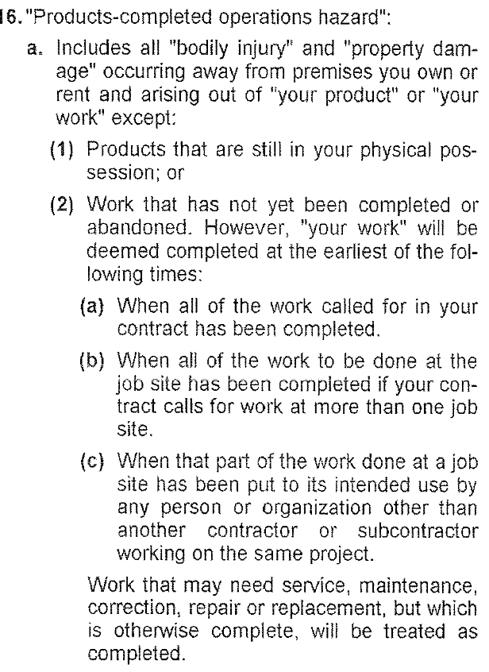
Tip #3
During Ops v. PCOH
Ongoing / During Operations
  NOT defined in Policies
PCOH (Products Completed Operations Hazard)
  AKA Completed Ops
  Defined in Policies
  DOES NOT = Substantial Completion
  DOES NOT = Certificate of Occupancy
1/1/17
Policy Start
1/1/18
Policy End
Final CO issued
3/15/18
2/4/17
Contract
12/1/17
PCOH Start
During Operations
PCOH →
Policy Period
Notes:
DAZ & DSC

Slide 27
Additional Insured Coverage
4/2013 ISO AI forms = heightened emphasis on contract language
CG 20 10 (04/13) ON GOING OPS | “The insurance afforded to such additional insured only applies to the extent permitted by law.” “If coverage provided to the additional insured is required by a contract or agreement, the insurance afforded to such additional insured will not be broader than that which you [the insured/Sub] are required by the contract or agreement to provide for such additional insured” “If coverage to the additional insured is required by a contract or agreement, the most [the insurer] will pay on behalf of the additional insured is the amount of insurance: 1. required by the contract or agreement; or 2. available under the applicable Limits of Insurance shown in the Declarations; whichever is less.”
CG 20 37 (04/13) COMPLETED OPS | Same limitations as CG 20 10 (04/13)

Slide 28
Contract Drafting Tips
Tip #4
“Limits of insurance to the AI shall be the greater of those set forth in the Contract or the full per occurrence limit in the Policy.”
  “Coverage for the AI shall be at least as broad as that afforded to the Named Insured.”
    AI Coverage ≠ broader than for the Named Insured
“…with respect to damages arising out of, in whole or in part, Subcontractor’s work (i.e. “your work”) during ongoing operations and for the products completed operations hazard period.”
“(1) CG 20 10 11 85 or its equivalent, OR (2) a combination of CG 20 10 04 13 AND CG 20 37 04 13”
“Primary & Non-Contributory”
Notes:
DAZ & DSC

Slide 29
All policies of liability insurance shall contain an Additional Insured Endorsement on ISO form at least as broad as: (1) CG 20 10 11 85 or its equivalent, OR (2) a combination of CG 20 10 (04/13) AND CG 20 37 (04/13), which name GC as an Additional Insured on a primary and noncontributing basis and said coverage shall include, at a minimum, additional insured status with respect to damages arising out of, in whole or in part, Subcontractor’s work (i.e. “your work”) during ongoing operations and for the products completed operations hazard period. Such insurance shall cover liability arising out of premises, operations, independent contractors, products-completed operations, personal and advertising injury, bodily injury, property damage, and liability assumed under an insured contract (including the tort liability of another assumed in a business contract). There shall be no endorsement or modification of the commercial general liability, excess or umbrella coverage forms which contains any of the following……..GC shall remain as an additional insured on each policy for a period not less than ten (10) consecutive years from the date of final completion of the entire construction project that is the subject of this Agreement and the Contract Documents regardless of the date when the Subcontractor, Subcontractor’s subcontractors, laborers, materialman, agents, employees, and/or anyone for whose acts any of them may be liable, completes or finishes any Work or any other construction work, and/or regardless of the dates any certificates of occupancy are issued. Subcontractor’s obligation to have GC remain as an additional insured on each policy for a period not less than ten (10) consecutive years from the date of final completion of the entire construction project will survive the expiration or earlier termination of this Agreement until any and all Claims are fully and finally barred by the greater of any and all applicable statute of limitation or statute of repose.
Notes:
DAZ & DSC

Slide 30
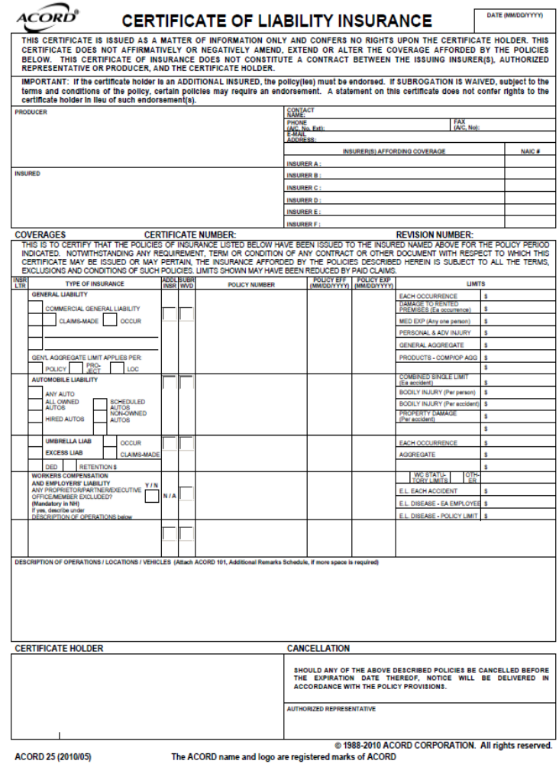
Tip #5
Get Policies
&
R-F-P
Do Not Rely on Certificates
THIS CERTIFICATE IS ISSUED AS A MATTER OF INFORMATION ONLY AND CONFERS NO RIGHTS UPON THE CERTIFICATE HOLDER. THIS CERTIFICATE DOES NOT AFFIRMATIVELY OR NEGATIVELY AMEND, EXTEND OR ALTER THE COVERAGE AFFORDED BY THE POLICIES BELOW. THIS CERTIFICATE OF INSURANCE DOES NOT CONSTITUTE A CONTRACT BETWEEN THE ISSUING INSURER(S), AUTHORIZED REPRESENTATIVE OR PRODUCER, AND THE CERTIFICATE HOLDER.
IMPORTANT: If the certificate holder is an ADDITIONAL INSURED, the policy(ies) must be endorsed. If SUBROGATION IS WAIVED, subject to the terms and conditions of the policy, certain policies may require an endorsement. A statement on this certificate does not confer rights to the certificate holder in lieu of such endorsement(s).

Slide 31
David A. Zulian
DAZulian@NaplesLaw.com
Debbie Sines Crockett DSCrockett@NaplesLaw.com
Cheffy Passidomo, P.A.
239-261-9300

