Slide 1

Presentation by Steve Goodfellow, Ph.D., CPCU

Slide 2
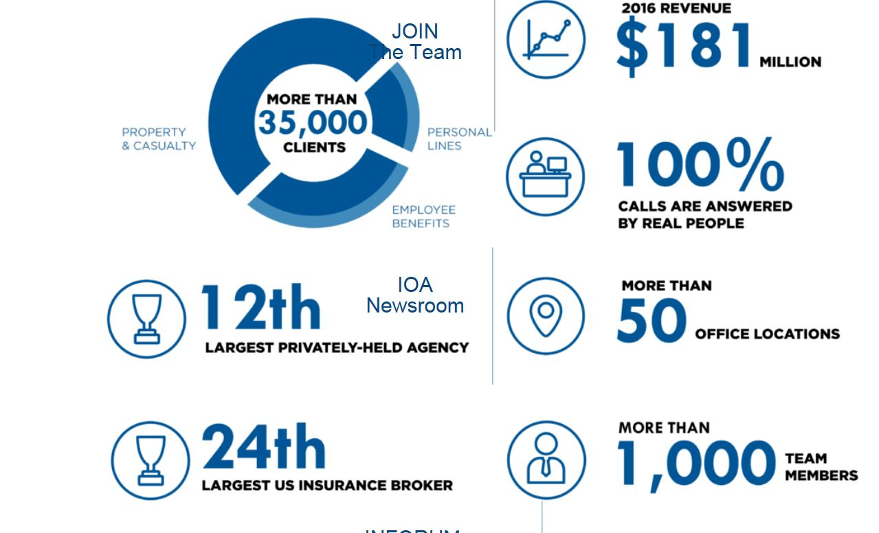
IOA At A Glance

Slide 3
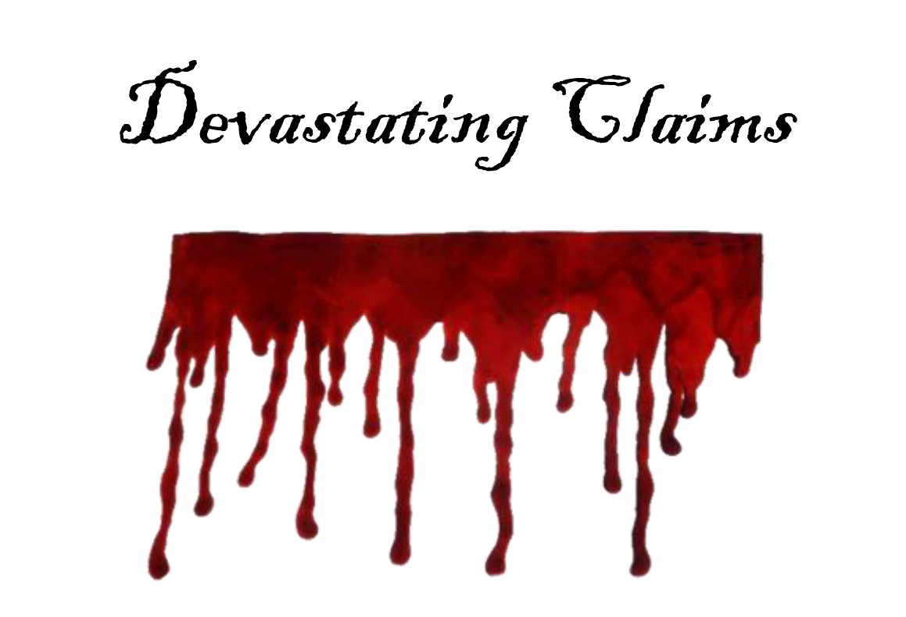

Slide 4

Sexual Harassment
Sheldon Management:
  Manages 7 Shopping Centers, 4 Apartment Communities, and 8 Office Buildings for Premier Properties
Insurance by Charlie
  Worker’s Comp
  General Liability
  Employment Practices Liability (Including Sexual Harassment)

Slide 5
Sexual Harassment
Situation:
  $2 Million suit filed January, 2014 against Sheldon Management, Premier Properties, and Harry Hart
  Allegation – Owner of postal service location and father of 17 year old daughter alleged Harry Hart, property manager for Sheldon, sexually molested his daughter at closing time on December 18, 2013. Daughter claimed to have hit Hart in the face with weighted tape machine.
  Because their Employment Practices Liability Policy did not include the “Third Party Liability Endorsement – Discrimination and Harassment of Non-Employees,” Premier is on its own unless held harmless by Sheldon.

Slide 6

Family Ties
Private Directors and Officers Liability Insurance
Reisman, International
  $700,000,000 in Assets
  $280,000,000
Stock:
  Father – 63%
  Mother – 18%
  Junior – 9%
  2 Daughters – 5% Each

Slide 7
Family Ties
Situation:
Daughter 1 is involved with drugs, has bad friends, and has developed damaging habits
  Value of stock: $25,000,000? $0?

Slide 8
Family Ties
2003 Reisman sold one location to Hines (German Co.) and management moved to Virginia Property Management Co.
  Redevelopment – 50 year old Diesel tank
    EPA > Hines
    Hines > Reisman
      $4,000,000 including legal. No insurance
Daughter 1 > Reisman for loss of stock value?
  Jury awards $5,000,000. No insurance

Slide 9
Family Ties
2007-2012
  40% of small businesses under 250 employees suffered D&O Loss
  $149,000 average if insured
  $450,000 if uninsured

Slide 10
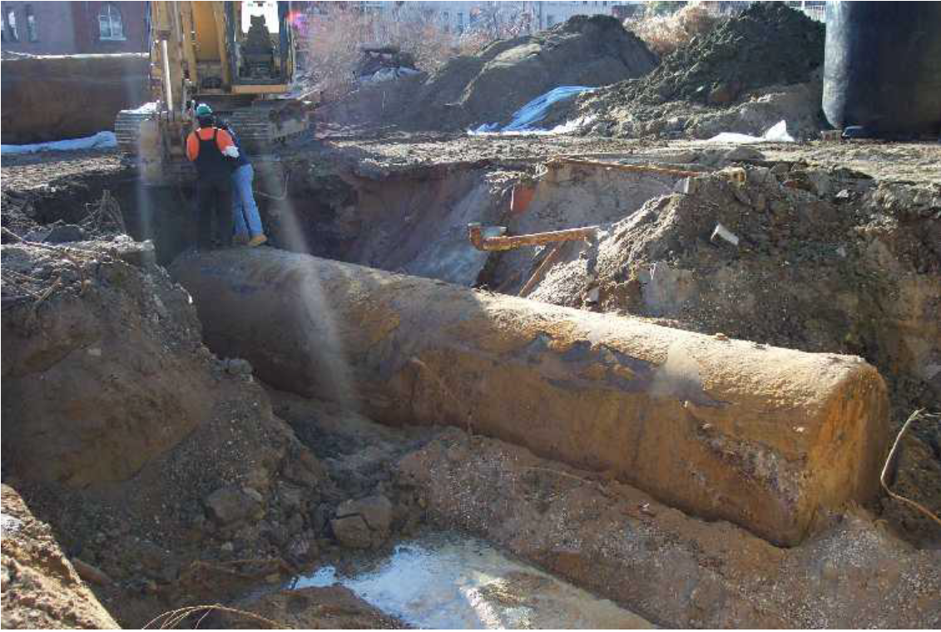
The 39 Year Old Claim
The Renewal Rule: Case Law says the insurance company must tell you in advance that there are restrictive changes in your insurance renewal
Obtained $1,870,000 from a 39 year old insurance policy! Huh?

Slide 11
The 39 Year Old Claim
Situation:
  In 1968, Treat Reit (TR) built a 100,000 Sq. Ft. shopping center in South Florida
  Insured by Argon International, renewed in 1969 and 1970
  Umbrella with AIG
TR sold to Not-So-Sweet Reit (NSSR) in 2006, including standard pollution hold harmless clause if discovered
Renovations stopped when pollution discovered in 2007
NSSR files $2,000,000 suit against TR

Slide 12
The 39 Year Old Claim
Judgment: $1,870,000 against TR
TR Seeks coverage from Argon International and AIG
Judgment:
  For Plaintiff, $1,870,000 plus legal fees
  Occurrence based policy+
Argon failed to reveal new ISO pollution exclusion on renewal to policyholders in 1969
Statute of Repose began in 2006 when NSSR took possession, so it does not apply
Argon pays $1,000,000 limit plus legal fees
AIG “Following Form” umbrella must do just that: follow form.
  Responsible for $870,000 excess

Slide 13
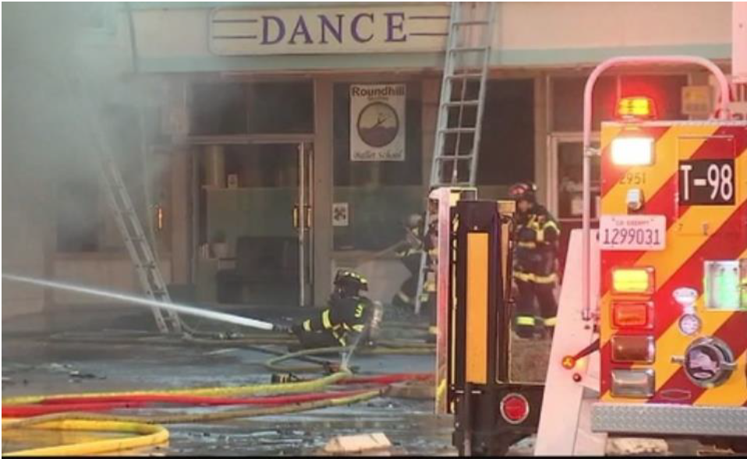
What You Can’t See CAN Hurt You
Situation: Somerville Plaza, 1994
312,000 Square Feet
Last unit, 8,000 sq. ft. vacant, caught fire Friday night. Only unit damaged. But, 298,000 square feet without power!
Food spoilage in supermarket, tenants move out, $1,600,000 in lost revenues

Slide 14
What You Can’t See CAN Hurt You
Insurance Company offers $48,000 - $5,000 deductible = $43,000. Huh?
Engineering Report: Music store had rock band practicing for 4 hours after closing using heavy duty amplifiers. Indications are that power surge was:
  Prolonged overheating, not lightning
  Insufficient to throw breakers
  Outside generator could not maintain both refrigeration and lighting in supermarket
Municipality required complete rewiring of the center, $2,000,000

Slide 15
What You Can’t See CAN Hurt You
Their Policy Stated:
  2. We will not pay for loss or damage caused by or resulting from any of the following:
    a. Artificially generated electrical, magnetic, or electromagnetic energy that damages, disturbs, disrupts, or otherwise interferes with any:
      (1) Electrical or electronic wire, device, appliance, system, or network; or
      (2) Device, appliance, system, or network utilizing cellular or satellite technology.
    For the purpose of this exclusion, electrical, magnetic, or electromagnetic energy includes but is not limited to:
      (a) Electrical current, including arcing;
      (b) Electrical charge produced or conducted by a magnetic or electromagnetic field;
      (c) Pulse of electromagnetic energy; or
      (d) Electromagnetic waves or microwaves.
  But if fire results, we will pay for the loss or damage caused by that fire.

Slide 16
What You Can’t See CAN Hurt You
Cost of Equipment Breakdown Coverage: $3,600
Savings: $1,600,000 - $3,600
Definition of Equipment Breakdown Insurance:
  Coverage for loss due to mechanical or electrical breakdown of nearly any type of equipment, including photocopiers and computers. Coverage applies to the cost to repair or replace the equipment and any other property damaged by the equipment breakdown.

Slide 17
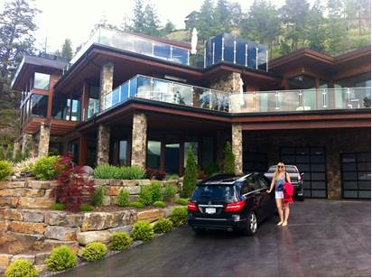
Company Owned Autos
Levinson Family: Commercial Property owners
All family members; includes over 18 Officers & Board Members
All family members provided “nice” cars
BAP – Officers, Directors, spouses > company vehicles only
Allen Agent > Broad Form Driver Other Car coverage added to the BAP

Slide 18
Company Owned Autos
Situation: Melanie was driving Patsy’s car with Patsy and 4 other friends. Ran red light, hit Mercedes 500 CL. Both totaled. 8 people in hospital.
Suit included Melanie’s parents
Levinson, Inc.’s insurance paid $30,000?
Insurance follows the car. Patsy’s limits soon exhausted.
$1,000,000 plus shortfall paid by Levinson, Inc. Why?

Slide 19
Company Owned Autos
AGENT ERROR!
BFDOC > Medical Payment and Uninsured Motorists
Must name every member individually and pay premium for each person for Liability coverage within the BFDOC form
PS: $1,000,000+ paid by Levinson, Inc. was declared taxable income to Mr. Levinson, resulting in nearly $400,000 in taxes, penalties, and interest.

Slide 20
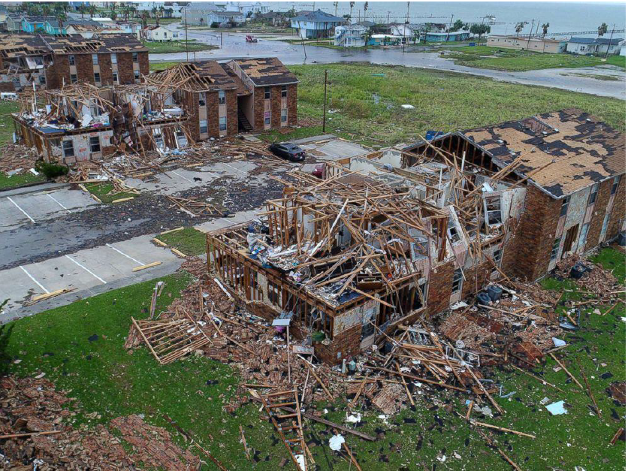
Preparation H(urricane)
Deciding what to buy: Priorities

Slide 21
Preparation H(urricane)
  Apartments Example:
    1. Per Building vs. Per Location
      17 Buildings, $21,760,000
      $1,280,000 per Building
      3% Named Storm
      $38,400 vs. $652,800
    2. Flood
      $500,000 Per Building
      Est. $3,500 in non-flood area
      $3,500 x 17 = $59,500
      Most good commercial policies provide excess of NFIP limits, up to $1M or $2.5M
  3. All Perils Deductible
    $5,000 - $10,000 - $25,000 Per Occurrence
    Includes wind other than Named Storm
  4. Wind vs. Named Storm Deductibles
    $25,000 vs. 2, 3, or 5%
  5. Minimum Named Storm Deductible
    $50,000 - $100,000 - $250,000
    Caution: could apply to each line of coverage
    Example: $1,280,000 x 3% = 38,400
    $192,000 LOR x 3% - $5,760
    3 buildings damaged - $132,480
    Minimum $250,000 = $0 Claim

Slide 22
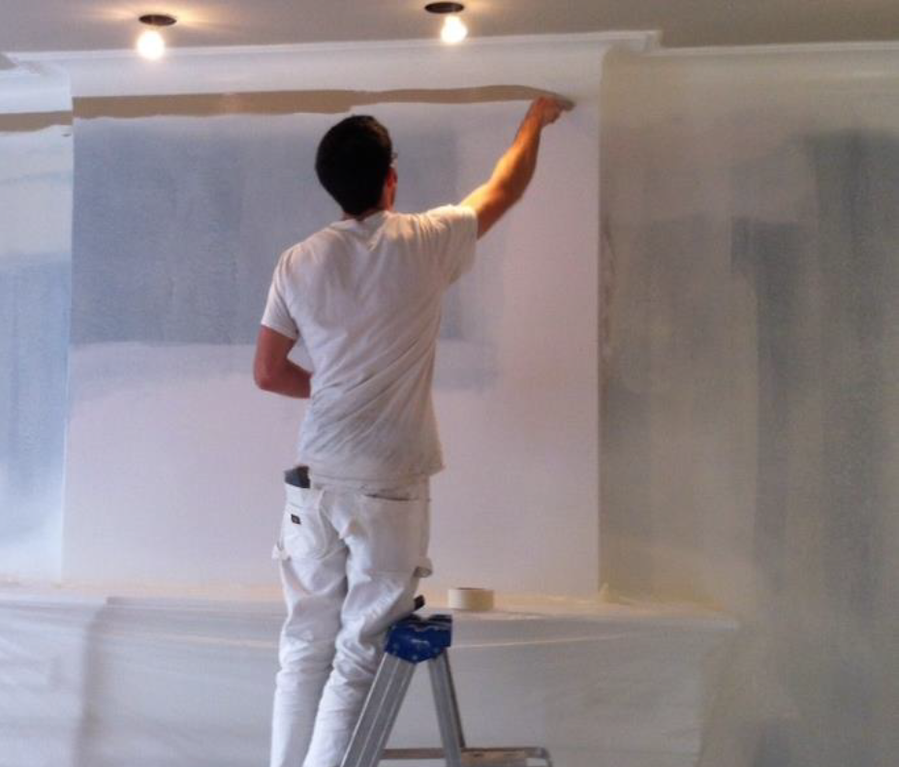
Unemployed Employees
Situation: Prosperous Apartments, LLC (Pro-Spa) hired tenant Tim. Tim bought CGL for $100,000 limits, no Workers Comp. Pre-school rush, got girlfriend to help. Allergic reaction leads to her hospitalization; coma for 11 weeks, $566,000

Slide 23
Unemployed Employees
Suit: Family sued Tim and Pro-Spa. Tim’s GL excluded Fellow Employees.
Judgment against Prosperous Apartments:
$566,000 WC + $300,000 GL + $350,000 Legal
BUT

Slide 24
Unemployed Employees
Employee Leasing:
  Pro-Spa’s payroll and Workers’ Comp was through ACT, a Preferred Employer Organization (PEO)
  ACT Contracted with Pro-Spa to handle the payroll and became the employer of record for Pro-Spa’s employees
  ACT provides Workers’ Comp and Employee Benefits to all of “its” employees
  Legally, Pro-Spa had no employees and no workers’ comp, so it had to pay the workers’ comp and legal fees out of its own pocket! Nearly $900,000!

Slide 25
Unemployed Employees
The contract reads:
“Client expressly agrees and understands that no employee shall become employed by ACT, covered by ACT’s workers’ compensation insurance or any other benefit or term and condition of employment, or issued a payroll check, unless the individual has completed Form I-9, and prior to commencing work for ACT, completed ACT employment application and W-4 withholding form. The employment application and W-4 withholding form must be delivered to ACT before the employee commences employment. ACT shall not be considered an employer for any employee until that individual completes these application and withholding forms.”

Slide 26
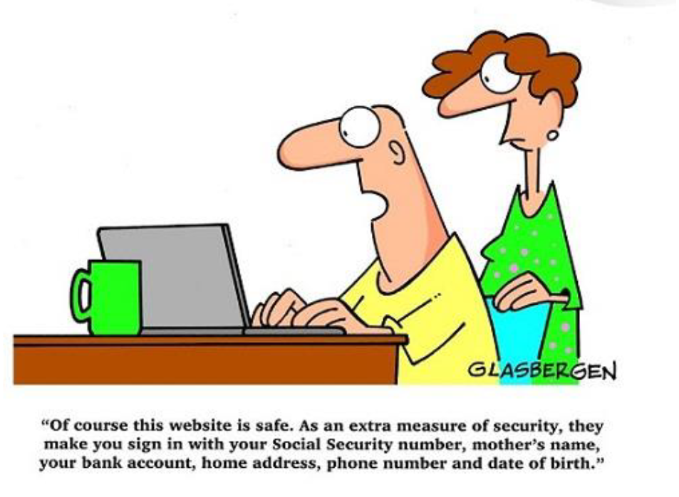
Privacy Breach

Slide 27
Privacy Breach
What do I do? Who do I report it to? What are the requirements? What constitutes legal compliance? What services do I obtain? What vendors do I utilize? How much should I budget for the event?
The cyber risks facing each and every commercial entity are evolving and developing hourly. Whether one is in real estate, construction, or manufacturing, the risks are real and growing. Privacy Injury, while not the exclusive cause of loss, is the most pervasive and the most common among non-technology based companies.

Slide 28
Privacy Breach – First Party Coverage
EACH OF THE FOLLOWING COVERAGES CAN EASILY BE PURCHASED IN A SINGLE PACKAGE:
  Forensic investigation. Covers the legal, technical or forensic services necessary to assess whether a cyber attack has occurred, to assess the impact of the attack and to stop an attack.
  Business interruption. Covers lost income and related costs where a policyholder is unable to conduct business due to a cyber event or data loss.
  Extortion. Provides coverage for the costs associated with the investigation of threats to commit cyber attacks against the policyholder's systems and for payments to extortionists who threaten to obtain and disclose sensitive information.
  Computer data loss and restoration. Covers physical damage to, or loss of use of, computer-related assets, including the costs of retrieving and restoring data, hardware, software or other information destroyed or damaged as the result of a cyber attack.
  Theft: Covers destruction or loss of the policyholder's data as the result of a criminal or fraudulent cyber event.

Slide 29
Privacy Breach – Third Party Coverage
EACH OF THE FOLLOWING COVERAGES CAN EASILY BE PURCHASED IN A SINGLE PACKAGE (Continued):
  Litigation and regulatory. Covers the costs associated with civil lawsuits, judgments, settlements or penalties resulting from a cyber event.
  Regulatory response. Covers the legal, technical or forensic services necessary to assist the policyholder in responding to governmental inquiries relating to a cyber attack, and provides coverage for fines, penalties, investigations or other regulatory actions.
  Notification costs. Covers the costs to notify customers, employees or other victims affected by a cyber event, including notice required by law.
  Crisis management. Covers crisis management and public relations expenses incurred to educate customers concerning a cyber event and the policyholder's response, including the cost of advertising for this purpose.
  Credit monitoring. Covers the costs of credit monitoring, fraud monitoring or other related services to customers or employees affected by a cyber event.
  Media liability. Provides coverage for media liability, including coverage for copyright, trademark or service mark infringement resulting from online publication by the insured.

Slide 30
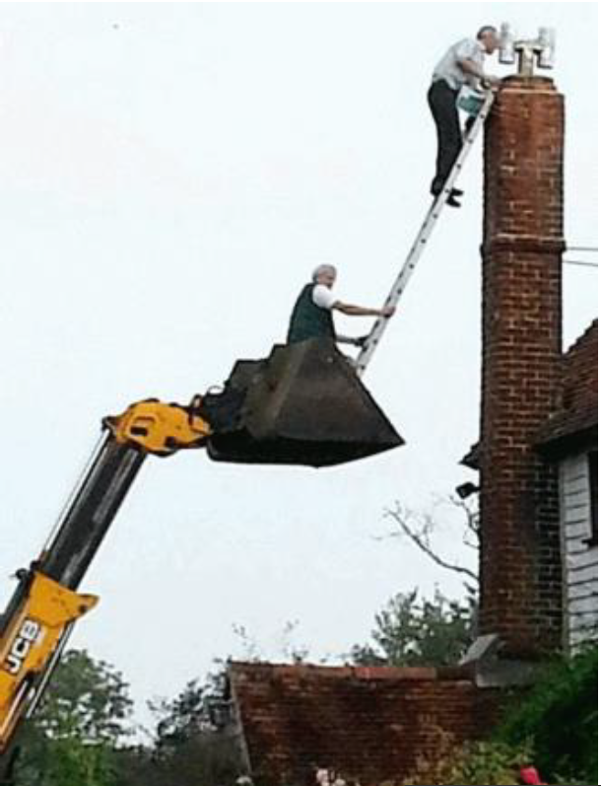
SCO Hires LMC

Slide 31
SCO Hires LMC
Situation: SCO hires LMC, Inc.to prepare space for new tenant (NT). SCO added as Additional Insured, Hold Harmless. LMC ladder strikes NT employee, NT files WC claim.
8 Months Later: NT’s Workers’ Comp company files suit to recover $190,000 Special Damages and SCO’s attorney enjoins $190,000 General Damages for hiring “uninsured contractor.” Non-pay prior to beginning of work.
Now what?
OCIP or Wrap – Owner Controlled Insurance Program
OCP – Owners and Contractors Protective

Slide 32
SCO Hires LMC
Contingent Liability: owners and contractors protective (OCP) liability coverage.
  A stand-alone policy that covers the named insured’s liability for bodily injury (BI) and property damage (PD) caused, in whole or in part, by an independent contractor’s work for the insured.
Paid for by the Contractor
Owner is Named Insured (doesn’t cover the contractor)
Owner covered in two situations:
  Vicarious liability due to contractors actions
  Direct liability for supervision of the job
Additional Insured and Hold Harmless still needed!

Slide 33
Miscellaneous Topics
Terrorism
Lifestyle Investment
Retirement through Insurance Waivers

Slide 34
Terrorism
Terrorism Risk Insurance Act (TRIA)
Certified act of terrorism means an act that is certified by the Secretary of the Treasury, in concurrence with the Secretary of State and the Attorney General of the United States, to be an act of terrorism pursuant to the federal Terrorism Risk Insurance Act.
The triggering event, the threshold for the program to go into effect, for the 2015 extension of the Act, is now $200 million, rising from the previous $100 million level in increments of $20 million for five years. It rose from $5 million under the original Act to $50 million after March 2006 to $100 million in *****. Only terrorist acts likely to produce total insurance industry losses above the threshold will result in payment of federal funds.

Slide 35
Terrorism
Private Terrorism – T3
Act of Terrorism means an act or series of acts, including use of force or violence, of any person or group(s) of persons, whether acting alone or on behalf of or in connection with any organization(s). Committed for political, religious, or ideological purposes including the intention to influence any government and/or put the public or any section of the public in fear for such purposes, which shall also include any act which is verified or recognized by the US Government as an act of Terrorism.

Slide 36
Lifestyle Income Planning
High Net Worth Male – Age 50
Perfect health, never smoked, dies at age 87

Slide 37
Lifestyle Income Planning – Option One
$50,000,000 20 Year Term – $95,075 per year
$50,000,000 10 Year Term at 70 – $365,700 per year
$50,000,000 Annual Term at 80 – Not Available
Total Cost: $5,558,500

Slide 38
Lifestyle Income Planning – Option Two
$50,000,000 Guaranteed Universal Life to age 100
$425,000 per year x 37 years
Premiums = $16,575,000
Proceeds = $50,000,000
Cost = $33,425,000

Slide 39
Lifestyle Income Planning – Option Three
Overfunding Indexed Universal Life
Insured pays $90,000 year for 15 years
Borrows $2,850,000 per year for 10 years at 5%
Cash value pays off all loans in year 15
Insured retirement income $1,100,000 per year to 89
Estate receives $50,000,000
Premium = $1,350,000
$23,100,000
$50,000,000
$73,100,000 - $1,350,000 = $71,750,000
IRR = 19.43%

Slide 40
Retirement Through Insurance Waivers
Captive Insurance Program for Apartment Owners
We add a one page lease addendum to your lease
  The lease addendum states that as a condition of renting a unit, we require our tenants to carry $100,000 of liability insurance
  Each tenant executes the lease addendum and has two options

Slide 41
Retirement Through Insurance Waivers
Provide Proof of $100,000 of Liability Coverage
Do Nothing, Automatically Enrolled in Tenant Waiver Program
If proof is provided, the policy information will be uploaded into your property management software and we will track the policy to ensure it is current
The tenant wavier program waives the tenants requirement to provide proof of insurance
The tenant waiver program waives the landlords right to go after the tenant for liability caused by fire, smoke, explosion, water damage, and falling objects
The waiver fee is $11 per month
Because of price point, ease of enrollment, and guaranteed issue, we expect 85% of tenants to enroll in our tenant waiver program

Slide 42
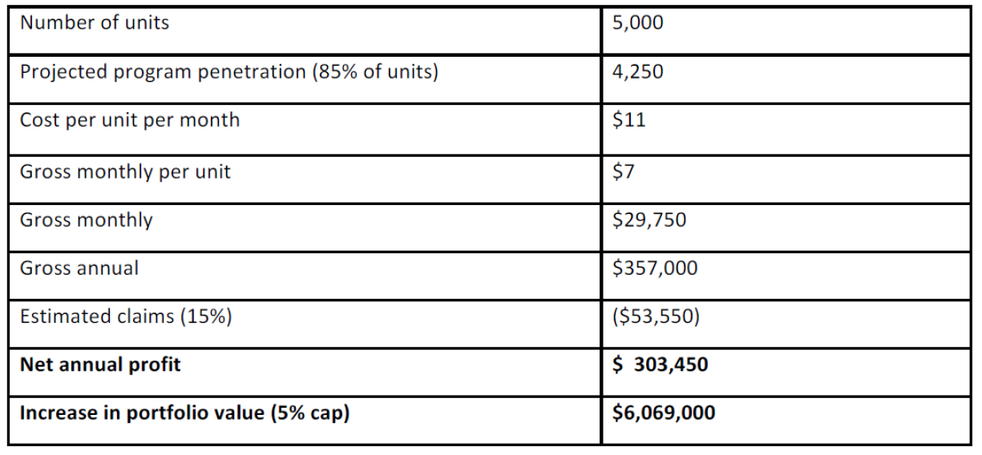
Retirement Through Insurance Waivers

Slide 43


