Slide 1
Prepared for: The Florida Bar Construction Law Committee
Stucco
(Cementitious Finish) Claims:
How to prevent, prepare for and defend them
Douglas K Gartenlaub
Burr & Forman LLP
(407) 540-6643
dgartenlaub@burr.com
200 South Orange Avenue, Suite 800, Orlando, FL 32801

Slide 2
PRE-SUIT
Prevention
  Annual Inspections (With written report to owner)
  Care instruction for Stucco installed (With owner sign off it was received)
Warranty Plans
  Insure the owner signs off on the Warranty and maintenance checklists
Independent inspections during construction

Slide 3
PRE-SUIT
Who is doing the work?
  How to prevent assignment to Sub-Contractors you don’t know
    Contract
    Supervision

Slide 4
20 / 20 HINDSIGHT
Remember when deciding what preventive measures to implement, you will unfairly be judged with 20/20 hindsight by attorneys, experts and judges
Preventive measures now can save or minimize a claim later
It cannot be said enough - DOCUMENT, DOCUMENT, DOCUMENT.

Slide 5
PRE-SUIT
What do the Plans say?
  Make sure what is on the plans goes into the building
  Changes from original Plans and Specifications during bidding (or after) – How to make sure everything still works together
  The gap between plans and buildings, and how to find and fill them (Pre-build work plan)

Slide 6
PRE-SUIT
558 Notices
  The claim must describe the defects and location in detail (See slide 8)
  How to use the process to settle claims and prepare for litigation
  What should your inspection look like?
    Review of Plans and Specifications
    Site Inspections
    Testing (if required)
    Report (if required)
    558 Written Response

Slide 7
NOTICE OF CLAIM UNDER 558.004
(1) (a) In actions brought alleging a construction defect, the claimant shall, at least 60 days before filing any action, or at least 120 days before filing an action involving an association representing more than 20 parcels, serve written notice of claim on the contractor, subcontractor, supplier, or design professional, as applicable, which notice shall refer to this chapter. If the construction defect claim arises from work performed under a contract, the written notice of claim must be served on the person with whom the claimant contracted.
(b) The notice of claim must describe in reasonable detail the nature of each alleged construction defect and, if known, the damage or loss resulting from the defect. Based upon at least a visual inspection by the claimant or its agents, the notice of claim must identify the location of each alleged construction defect sufficiently to enable the responding parties to locate the alleged defect without undue burden. The claimant has no obligation to perform destructive or other testing for purposes of this notice.
(c) The claimant shall endeavor to serve the notice of claim within 15 days after discovery of an alleged defect, but the failure to serve notice of claim within 15 days does not bar the filing of an action, subject to s. 558.003. This subsection does not preclude a claimant from filing an action sooner than 60 days, or 120 days as applicable, after service of written notice as expressly provided in subsection (6), subsection (7), or subsection (8).

Slide 8
INSPECTIONS UNDER CHAPTER 558
Right to inspect 558.004
  (2) Within 30 days after service of the notice of claim, or within 50 days after service of the notice of claim involving an association representing more than 20 parcels, the person served with the notice of claim under subsection (1) is entitled to perform a reasonable inspection of the property or of each unit subject to the claim to assess each alleged construction defect

Slide 9
CHAPTER 558 & SETTLEMENT
Get your sub-contractors and suppliers notified under Chapter 558.004
Once the inspection is completed a value should be put on the case and an offer to settle or mediate made
Pre-suit mediation can be effective at this point and Chapter 558 and the Statute of Limitations can be tolled pending the outcome

Slide 10
PRE-SUIT
Unlicensed Contracting
  Penalties
    Loss of qualifier status
    Civil, Criminal and Administrative penalties
    Loss of Civil Remedies under contract, equity or lien
  Common pitfalls
    Who is your qualifier
    Are they involved
    Is the entity doing the work the qualified entity
    Does the qualified entity hold the contract

Slide 11
PRE-SUIT
Use of Warranty Program to prevent and identify problem claims
  Know the terms of your warranty
  Look for and identify the problem client
    Frustration leads to lawsuits
    Special attention now can prevent lawsuits latter
    Document Document Document
    If an agreement is reached to exceed the warranty make sure the terms are documented

Slide 12
PRE-SUIT
Common Causes of Problems in Construction
  Value Engineering
  Changes in materials during bidding
  Lacking or insufficient details
  Insufficient supervision
  Insufficient inspection

Slide 13
DOCUMENTING THE CLAIM
You have documents USE them
All contracts and documents should be fully and completely signed by all parties. A partially signed documents may be worse than useless
Take pictures or other photographic evidence and save them in the proper place
Properly back up your records
Emails, emails and more e-mails
Know your Contract and follow it
FOLLOW UP, FOLLOW UP AND FOLLOW UP!!

Slide 14
AFTER THE SUIT IS FILED
Common Defenses
  Maintenance
  Economic Loss Rule (ELR)
  Comparative negligence
  Contract Provisions
    Consequential damages waivers
    Change orders
    Jury trial waivers
    Arbitration and mediation

Slide 15
AFTER THE SUIT IS FILED
Common Claims
  Chapter 553
  Unfair and Deceptive Trade Practices under Florida Statute 501.204 et seq.
  Unlicensed contracting
  Breach of Contract
  Negligence

Slide 16
CIVIL ACTION FOR VIOLATION
OF BUILDING CODES
553.84 Statutory civil action.—Notwithstanding any other remedies available, any person or party, in an individual capacity or on behalf of a class of persons or parties, damaged as a result of a violation of this part or the Florida Building Code, has a cause of action in any court of competent jurisdiction against the person or party who committed the violation; however, if the person or party obtains the required building permits and any local government or public agency with authority to enforce the Florida Building Code approves the plans, if the construction project passes all required inspections under the code, and if there is no personal injury or damage to property other than the property that is the subject of the permits, plans, and inspections, this section does not apply unless the person or party knew or should have known that the violation existed.

Slide 17
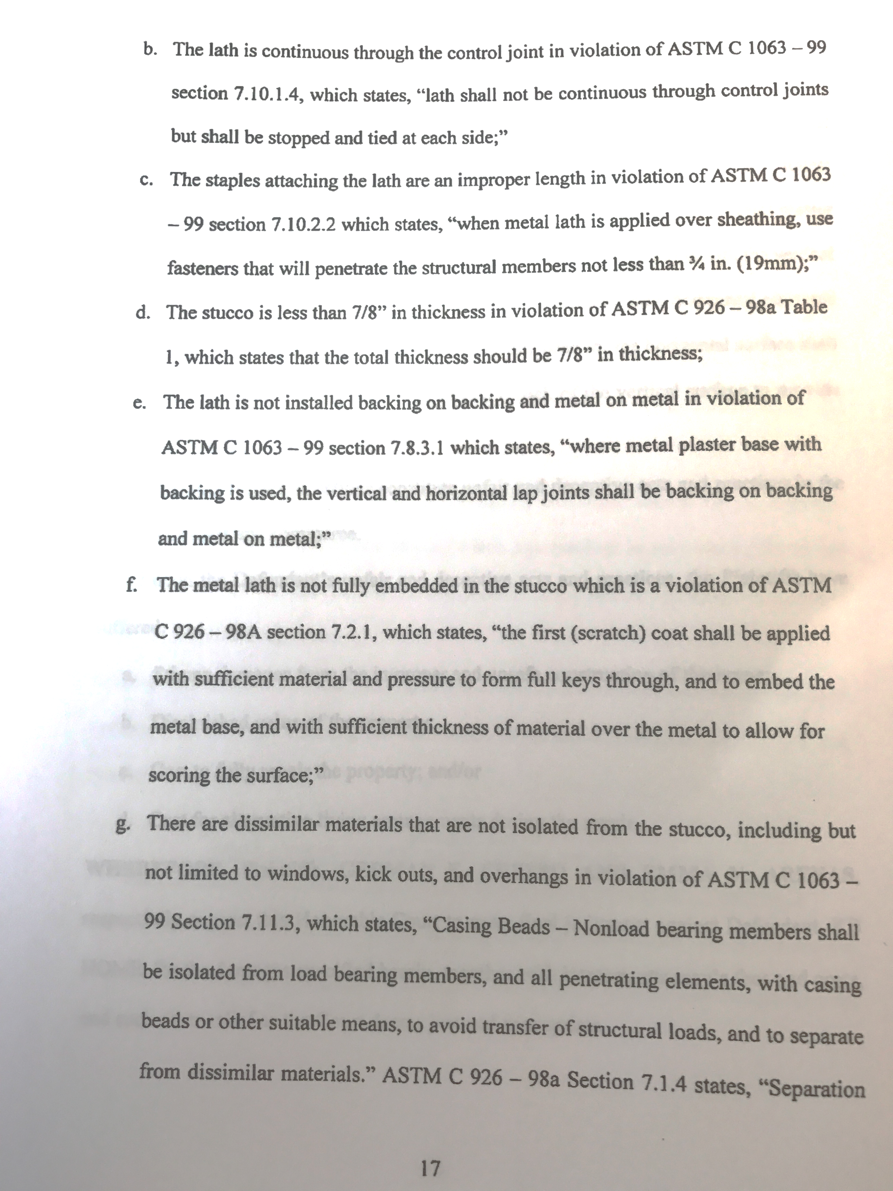
Example of claim for
violation of Chapter 553

Slide 18
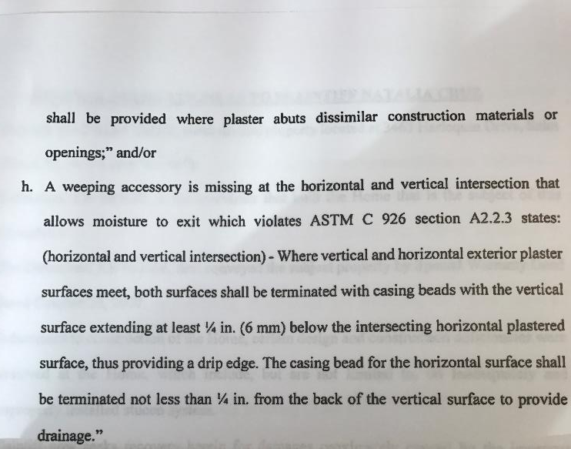
Example of claim for
violation of Chapter 553

Slide 19
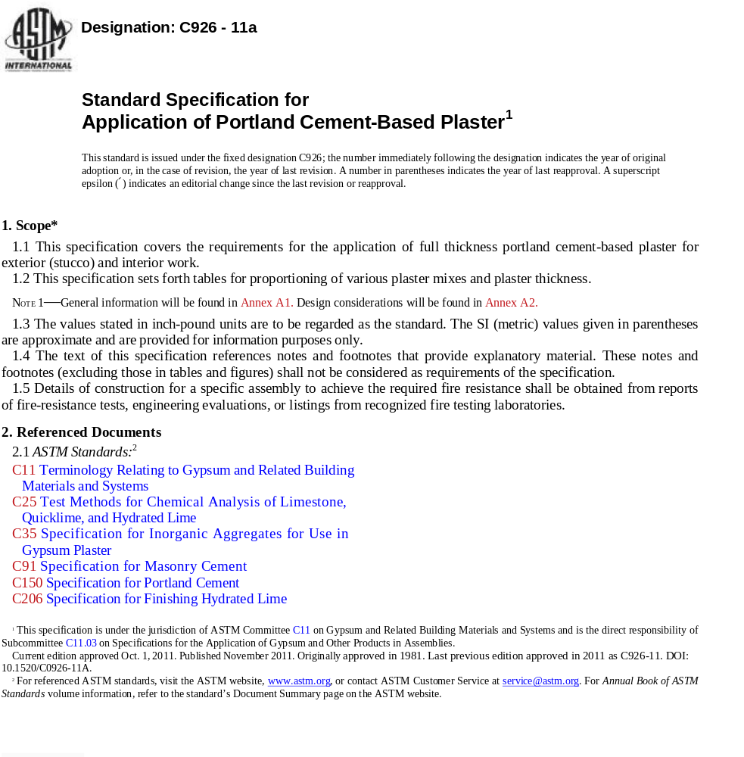
ASTM STANDARD FOR APPLICATION of Portland Cement-based Plaster

Slide 20
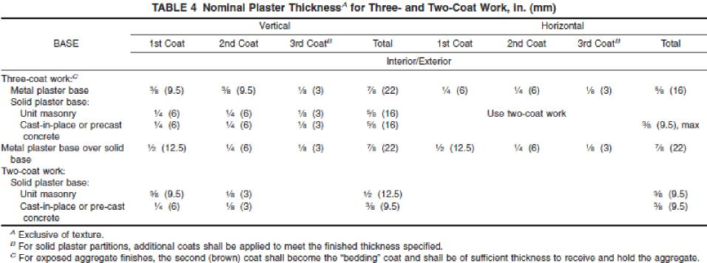
ASTM STANDARD FOR THICKNESS

Slide 21
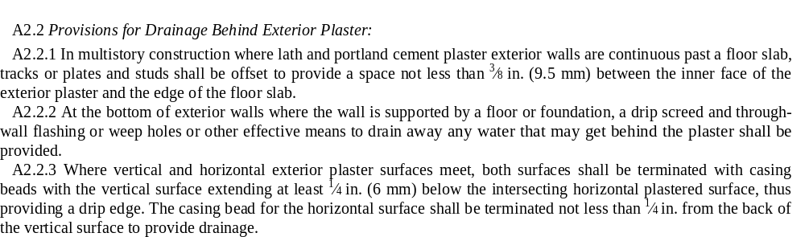
ASTM STANDARD FOR DRAINAGE BEHIND EXTERIOR PLASTER

Slide 22
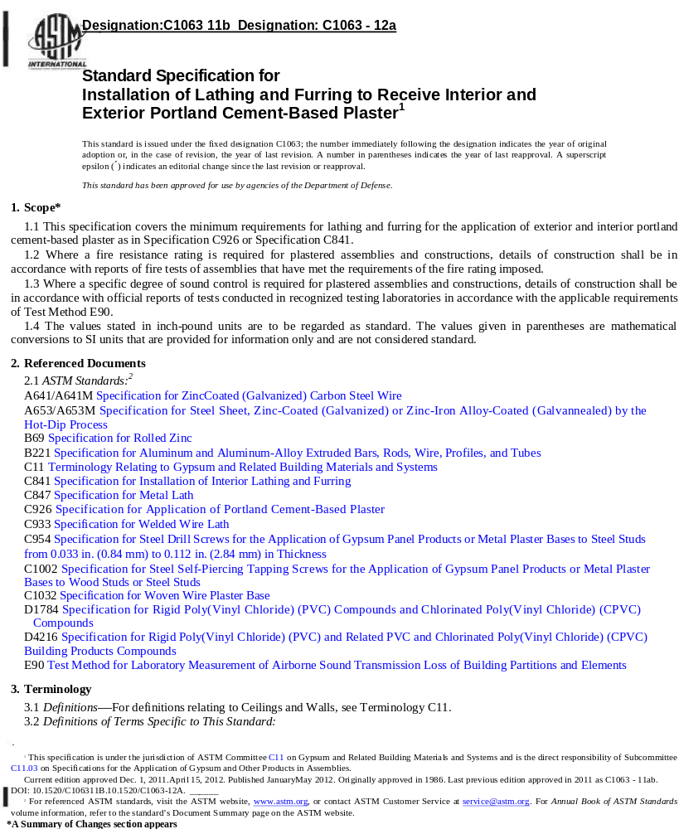
ASTM STANDARD C 1063

Slide 23
USE OF PRODUCTS OTHER THAN TRADITIONAL STUCCO
One-coat stucco systems do not comply with ASTM Standard C 1063 and Standard C 926 in the FBC. All systems not conforming with ASTM Standards must be approved in writing by the local Building Official as alternative methods per the FBC Section 104.11 unless there is State product approval.
If used, they should be specified on the drawings at the time of permitting along with installation requirements and details for that specific product, including but not limited to, lathing, termination, backing and flashing details and any local or State approval must be documented.
A permit and inspection of a wall were the product is used does NOT mean you have documented approval of a product unless the above is complied with.
Information to assist in obtaining approval can often be obtained from your supplier or the manufacturer. They want you to use their products make them your ally!

Slide 24
UNLICENSED CONTRACTORS
768.0425 Damages in actions against contractors for injuries sustained from negligence, malfeasance, or misfeasance.—
(1) For purposes of this section only, the term “contractor” means any person who contracts to perform any construction or building service which is regulated by any state or local law, including, but not limited to, chapters 489 and 633; and the term “consumer” means a person who contracts for the performance of any construction or building service which is regulated by any state or local law, including, but not limited to, chapters 489 and 633.
(2) In any action against a contractor for injuries sustained resulting from the contractor’s negligence, malfeasance, or misfeasance, the consumer shall be entitled to three times the actual compensatory damages sustained in addition to costs and attorney’s fees if the contractor is neither certified as a contractor by the state nor licensed as a contractor pursuant to the laws of the municipality or county within which she or he is conducting business.

Slide 25
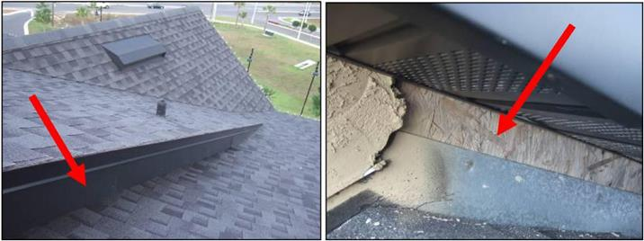
Exposed wood in hidden areas

Slide 26
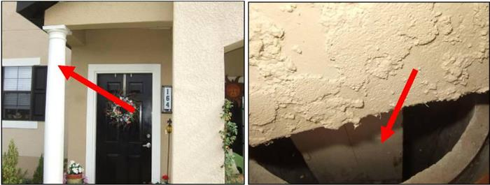
Un-Capped Columns

Slide 27
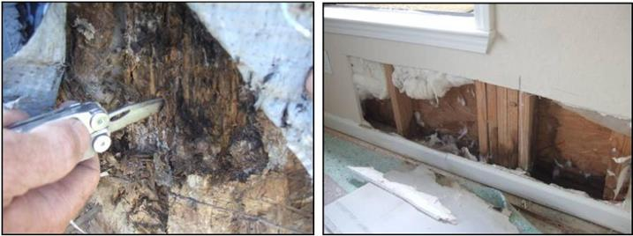
Water damage caused by improper wall assembly

Slide 28
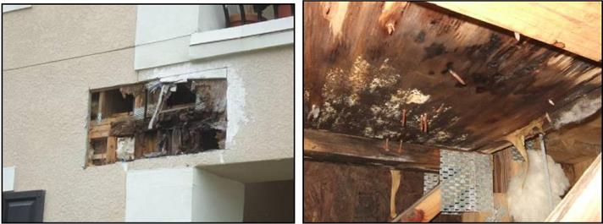
Water damage caused by defects in balcony construction

Slide 29
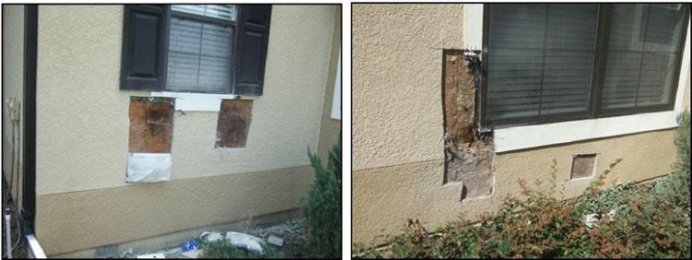
Water damage caused by defective or damaged windows and window installation and stucco issues.

Slide 30
WHO SELECTS YOUR ATTORNEY AND IS HE THE RIGHT ATTORNEY FOR YOU?
Normally selection is controlled by the insurance company
Control of the selection can occur through:
  Statute
  Informal discussion
  Endorsement

Slide 31
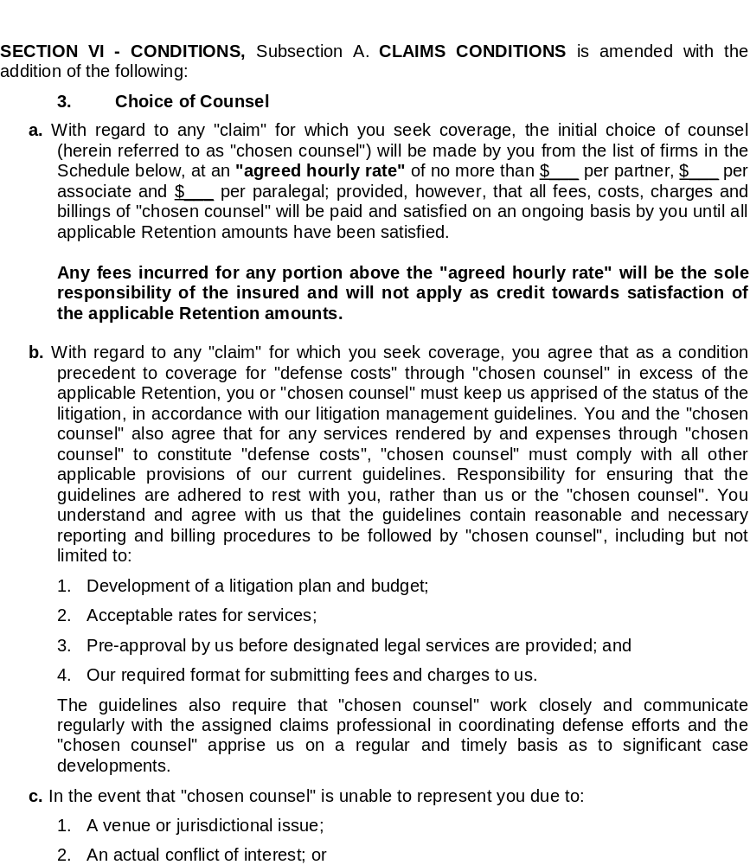
Example Policy Endorsement

Slide 32
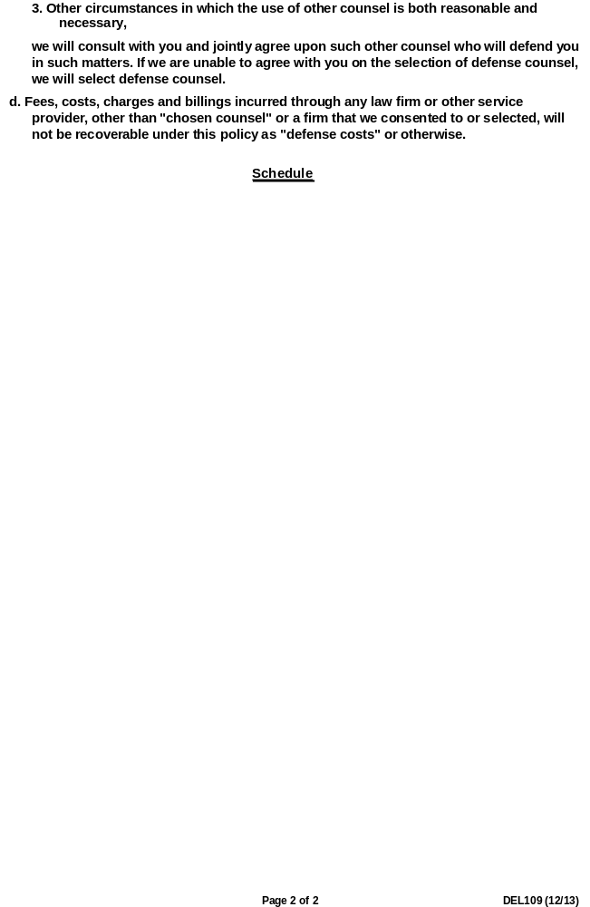
Example Policy Endorsement
(continued)

Slide 33



The right attorney for you?
Douglas K. Gartenlaub | 407-540-6643 | dgartenlaub@burr.com
Douglas is a partner whose practice is primarily focused on representing clients in disputes related to construction and other matters related to real estate.
He is board certified in Business Litigation, representing owners, contractors and developers in a broad range of disputes ranging from complex multi party construction and real estate matters to title disputes. As part of this practice, Douglas represents his clients in land use and regulatory matters related to construction and land use.

Slide 34
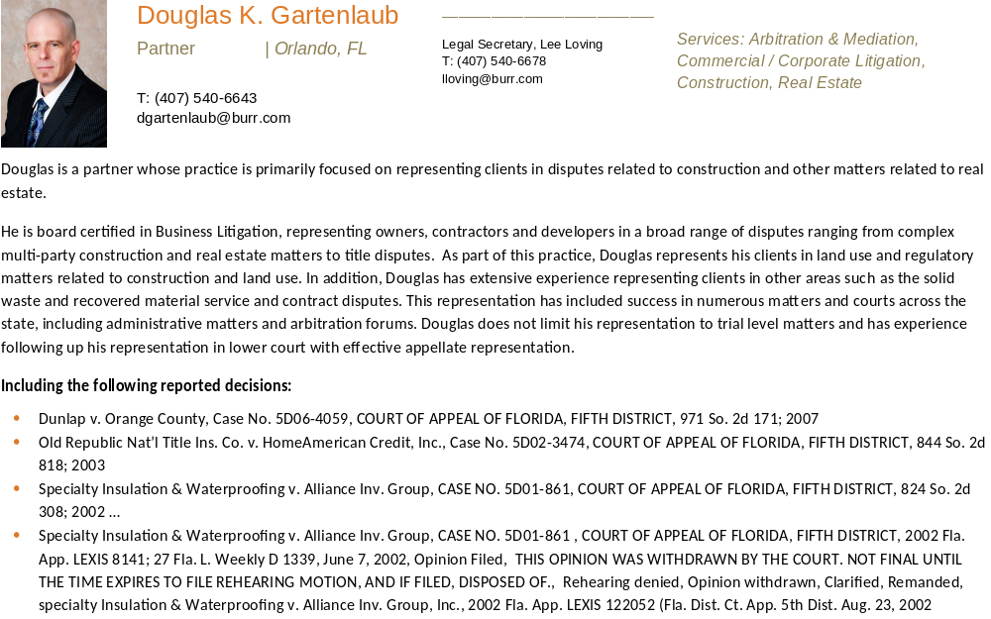

Slide 35
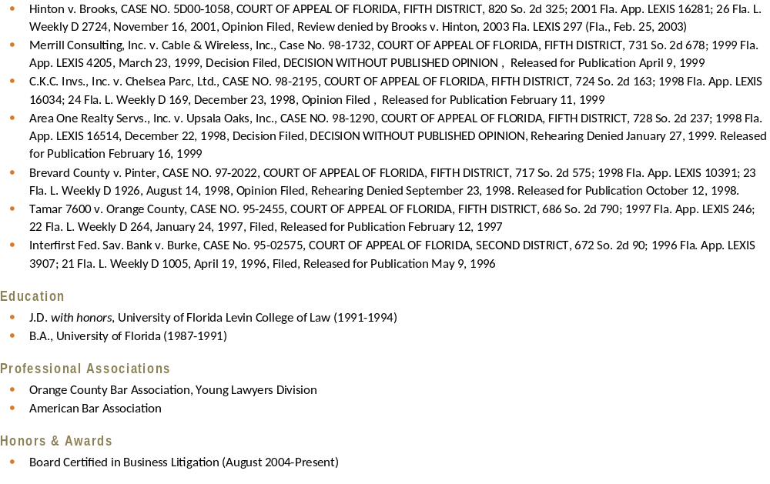

Slide 36
