Slide 1
The Effect of the Confusion over the difference between Consequential and Direct Damages on Consequential Damage Waiver Provisions
Douglas K. Gartenlaub
T: (407) 540-6643

Slide 2
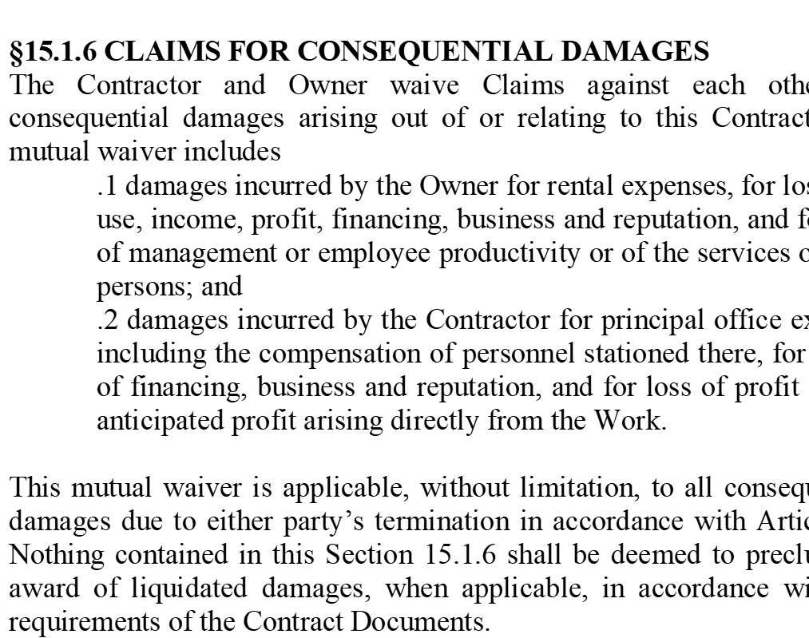
Article 15 of the A201
Article 15 of the A201 may be the most well known consequential damages waiver, despite the fact there is little case law interpreting this provision. The lack of case law is probably because the default forum for most litigation under the AIA document is arbitration, which produces little if any case law on such a subject.

Slide 3
Consequential Damages are Valid and Enforceable Under Florida Law
Although there are no Florida cases interpreting the A101-2007 consequential damages waiver provision, the Courts of Florida have found contractual waivers of consequential damages valid and enforceable. Ament v. One Las Olas, Ltd., 898 So. 2d. 147, 150 (Fla. 4th DCA 2005); Also See, e.g., Paul Gottlieb & Co., Inc. v. Alps South Corp., 985 So. 2d 1, 8 (Fla. 2d DCA 2007) (finding trial court erred in not enforcing waiver of consequential damages clause in UCC contract).

Slide 4
Consequential Damages are Valid and Enforceable Under Florida Law
In Ament, the Court overturned a trial Court ruling refusing to enforce a waiver of consequential damages provision that limited buyer to the return of its deposit in a dispute regarding the pre-construction purchase of a luxury condominium. See Ament v. One Las Olas, Ltd., 898 So. 2d. 147, 150.
In so holding the Court stated, “We hold that paragraph 15 prevents the purchaser from recovering damages beyond the return of his deposit. In this case, not only were damages limited, but the purchaser expressly waived his right to collect more than that specified in paragraph 15. Such a waiver must be enforced.” Id at 150. The Court further stated, “Parties may contractually limit damages for breach.” Id at 151.

Slide 5
Liquidated Damages
It is common to include liquidated damages in Contracts waiving consequential damages.
Though not required it helps Courts accept the waiver and provides a strong counter argument to the assertion that the contract is rendered illusorily or one-sided.
Liquidated damages substitute for the waived consequential damages and provide a specific allocation and certainty of for risk factors caused by an unauthorized delay.

Slide 6
Liquidated Damages are Enforceable in Florida Subject to Some Restrictions
It is well settled that in Florida the parties to a contract may stipulate in advance to an amount to be paid or retained as liquidated damages in the event of a breach. Poinsettia Dairy Prods. v. Wessel Co., 123 Fla. 120, 166 So. 306 (1936); Southern Menhaden Co. v. How, 71 Fla. 128, 70 So. 1000 (1916). In Hyman v. Cohen, 73 So. 2d 393 (Fla. 1954).
Commonly the parties to a Construction contract set an amount for each day of delay in place of the waived right to seek consequential damages. This is not required but does make the analysis easer for court enforcing these provisions.

Slide 7
Liquidated Damages Cannot be a Penalty
Keep in mind that liquidated damages cannot be so grossly disproportionate to any damages that might reasonably be expected to follow from a breach of the contract so as to show that the parties intended only to induce full performance. See Hooper v. Breneman, 417 So. 2d 315 (Fla. 5th DCA 1982)

Slide 8
Practice Tip – Liquidated Damages Cannot be the Option of One Party
One Party cannot have the option to take the liquidated damages or choose their actual damages.
“The reason why the forfeiture clause must fail in this case is that the option granted to Baron either to choose liquidated damages or to sue for actual damages indicates an intent to penalize the defaulting buyer and negates the intent to liquidate damages in the event of a breach.” See Lefemine v. Baron, 573 So. 2d 326, 329 (Fla. 1991).

Slide 9
The Recent Florida Decision of Keystone Airpark v. Pipeline Construction
In Keystone Airpark v. Pipeline Construction. 266 So3d 1219 the 1st DCA 2019). The Court specifically upheld a grant of summary judgment on a claim for consequential damages. In an excellent discussion the Court addressed the consequential damages versus direct damages distinction.

Slide 10
Keystone Airpark (Continued)
It explains "[C]consequential damages 'do not arise within the scope of the immediate buyer-seller transaction, but rather stem from losses incurred by the non-breaching party in its dealings, often with third parties, [*1223] which were a proximate result of the breach, and which were reasonably foreseeable by the breaching party at the time of contracting.'" Hardwick, 711 So. 2d at 40 (emphasis added) (quoting Petroleo Brasileiro, S.A., Petrobras v. Ameropan Oil Corp., 372 F. Supp. 503, 508 (E.D.N.Y. 1974)). "The consequential nature of loss . . . is not based on the damages [**7] being unforeseeable by the parties. What makes a loss consequential is that it stems from relationships with third parties, while still reasonably foreseeable at the time of contracting." Bartram, LLC v. Landmark Am. Ins. Co., 864 F. Supp. 2d 1229, 1240 (N.D. Fla. 2012) (emphasis added) (citing Hardwick Properties, Inc. v. Newbern, 711 So. 2d at 40).

Slide 11
Can Direct Damages Be Caused By A Delay if There is a Specific Provision Stating the Contractor Shall Not Delay the Project
A common argument made in an attempt to transform lost profits caused by a delay from consequential damages into direct damages is that the contract contained a specific requirement that the Contractor not delay the project. This argument was made and rejected in Atl. City Assocs. The Court explains that damages are not "direct" just because they are the foreseeable result of a breach. Rather, the Court explained, "New Jersey has adopted the traditional rule of Hadley v. Baxendale, 9 Ex. 341, 156 Eng. Rep. 145 (1854), that consequential damages are available for those delays that may fairly and reasonably be supposed to have been in the contemplation of the parties to the contract at the time it was made, as the probable result of the breach."

Slide 12
Explaining the Difference Between Direct and Consequential Damages
In explaining the difference, the Third Circuit explained, “Rather than turning on foreseeability, the difference between direct and consequential damages depends on whether the damages represent (1) a loss in value of the other party's performance, in which case the damages are direct, or (2) collateral losses following the breach, in which case the damages are consequential. See Atl. City Assocs., LLC v. Carter & Burgess Consultants, Inc., 453 Fed. Appx. 174 (US 3RD CIR 2011)

Slide 13
Atlantic Associates (Continued)
The Court in Atlantic City Associates rejected as consequential damages claims for lost rental income, additional payments to contractors due to delay, and additional administrative costs.
The Court explained the direct damages in that case where a loss in value of ACA's performance. These damages were in the form of additional construction costs necessary to repair the errors in ACA’s performance. They were direct because they were the damages that allowed the damaged party to recover the value of what it had bargained for under the contract.

Slide 14
Waiver of Consequential Damages Do Not Render A Contract Illusory If There is Still A Remedy
Section 9.5 DECISIONS TO WITHHOLD CERTIFICATION clearly states in
§ 9.5 DECISIONS TO WITHHOLD CERTIFICATION
§ 9.5.1 The Architect may withhold a Certificate for Payment in whole or in part, to the extent reasonably necessary to protect the Owner, if in the Architect’s opinion the representations to the Owner required by Section 9.4.2 cannot be made. If the Architect is unable to certify payment in the amount of the Application, the Architect will notify the Contractor and Owner as provided in Section 9.4.1. If the Contractor and Architect cannot agree on a revised amount, the Architect will promptly issue a Certificate for Payment for the amount for which the Architect is able to make such representations to the Owner. The Architect may also withhold a Certificate for Payment or, because of subsequently discovered evidence, may nullify the whole or a part of a Certificate for Payment previously issued, to such extent as may be necessary in the Architect’s opinion to protect the Owner from loss for which the Contractor is responsible, including loss resulting from acts and omissions described in Section 3.3.2, because of
§ 9.5.2 When the above reasons for withholding certification are removed, certification will be made for amounts.

Slide 15
Waiver of Consequential Damages Do Not Render A Contract Illusiary
§ 14.2 TERMINATION BY THE OWNER FOR CAUSE
§ 14.2.1 The Owner may terminate the Contract if the Contractor
§ 14.2.2 When any of the above reasons exist, the Owner, upon certification by the Initial Decision Maker that sufficient cause exists to justify such action, may without prejudice to any other rights or remedies of the Owner and after giving the Contractor and the Contractor’s surety, if any, seven days’ written notice, terminate employment of the Contractor and may, subject to any prior rights of the surety:
repeatedly refuses or fails to supply enough properly skilled workers or proper materials;
fails to make payment to Subcontractors for materials or labor in accordance with the respective agreements between the Contractor and the Subcontractors;
repeatedly disregards applicable laws, statutes, ordinances, codes, rules and regulations, or lawful orders of a public authority; or
otherwise is guilty of substantial breach of a provision of the Contract Documents.
Exclude the Contractor from the site and take possession of all materials, equipment, tools, and construction equipment and machinery thereon owned by the Contractor;
Accept assignment of subcontracts pursuant to Section 5.4; and
Finish the Work by whatever reasonable method the Owner may deem expedient. Upon written request of the Contractor, the Owner shall furnish to the Contractor a detailed accounting of the costs incurred by the Owner in finishing the Work.

Slide 16
(Continued)
§ 14.2.3 When the Owner terminates the Contract for one of the reasons stated in Section 14.2.1, the Contractor shall not be entitled to receive further payment until the Work is finished.
§ 14.2.4 If the unpaid balance of the Contract Sum exceeds costs of finishing the Work, including compensation for the Architect’s services and expenses made necessary thereby, and other damages incurred by the Owner and not expressly waived, such excess shall be paid to the Contractor. If such costs and damages exceed the unpaid balance, the Contractor shall pay the difference to the Owner. The amount to be paid to the Contractor or Owner, as the case may be, shall be certified by the Initial Decision Maker, upon application, and this obligation for payment shall survive termination of the Contract.

Slide 17
No Damages For Delay Cases
McIntire v. Green-Tree Cmtys., Inc., 318 So. 2d 197 (Fla. 2d DCA 1975) and S. Gulf Utilities, Inc. v. Boca Ciega, 238 So 2d 458,259 (Fla 2d DCA 1970).
In McIntire the Court specifically stated, “These clauses have generally been held to be valid. However, they are normally ineffective where the delay is caused by the active interference, concealment or fraud of the party seeking the benefit of the provision.” McIntire v. Green-Tree Cmtys., Inc., 318 So. 2d 197, 199 (Fla. 2d DCA 1975).
Often confused with consequential damages waivers by both attorneys and courts.

Slide 18
Summation
Consequential damages provisions are valid in Florida
  There is often confusion over what is consequential and what is direct
  Keep in mind when determining of a damages is Consequential, “"The consequential nature of loss . . . is not based on the damages [**7] being unforeseeable by the parties. What makes a loss consequential is that it stems from relationships with third parties, while still reasonably foreseeable at the time of contracting."
Inclusion of a consequential damages provision is often partnered with a liquidated damages provisions
No damages for delay provisions are not the same but are often confused by courts as the same

Slide 19
Practice Tip re: Waiver of Consequential Damages
Discuss with your client pre-contract whether consequential damages waivers are important to them, you will be stunned how many sophisticated client don’t understand what they are or if they are present in their contracts.
If consequential damages are important you need to decide what for they are most likely to be enforced in….Arbitration or Court.
Inclusion of liquidated damages will make enforcement easier as it undermines key argument against enforcement like mutuality of remedy and illusory contract.

Slide 20
Questions?

Slide 21

Attorney Information
Douglas K. Gartenlaub
Board-certified in Business Litigation, representing owners, contractors, and developers in a broad range of disputes ranging from complex multi-party construction and real estate matters to title disputes
Extensive experience representing clients in other areas such as the solid waste and recovered material service and contract disputes
Represents his clients in land use and regulatory matters related to construction and land use
Extensive experience in post-judgment collections including replevin, garnishment, and similar actions
Partner | Orlando, FL
T: (407) 540-6643
dgartenlaub@burr.com

